Slide 1
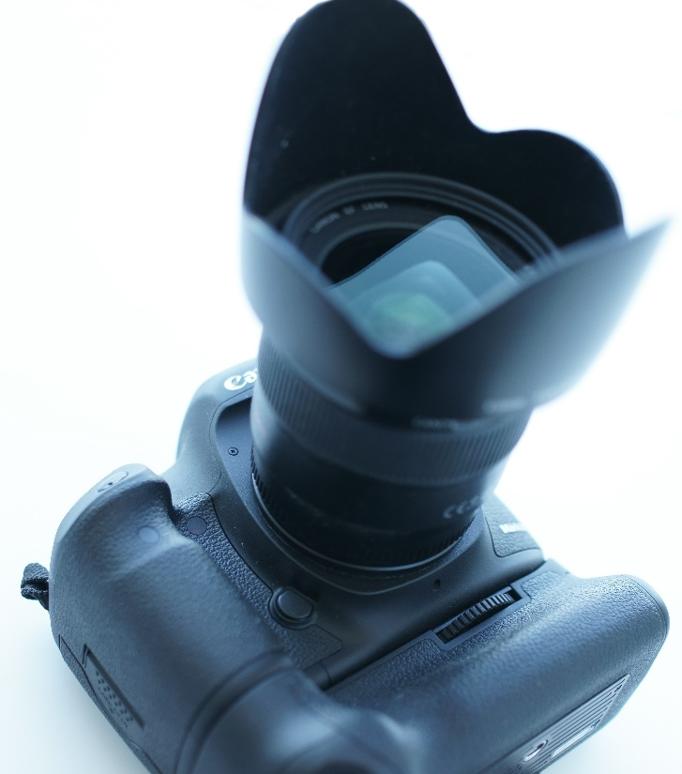
Real Camera Real-time Rendering of Physically Based Optical Effects in Theory and Practice Yoshiharu Gotanda tri-Ace, Inc.

Slide 2
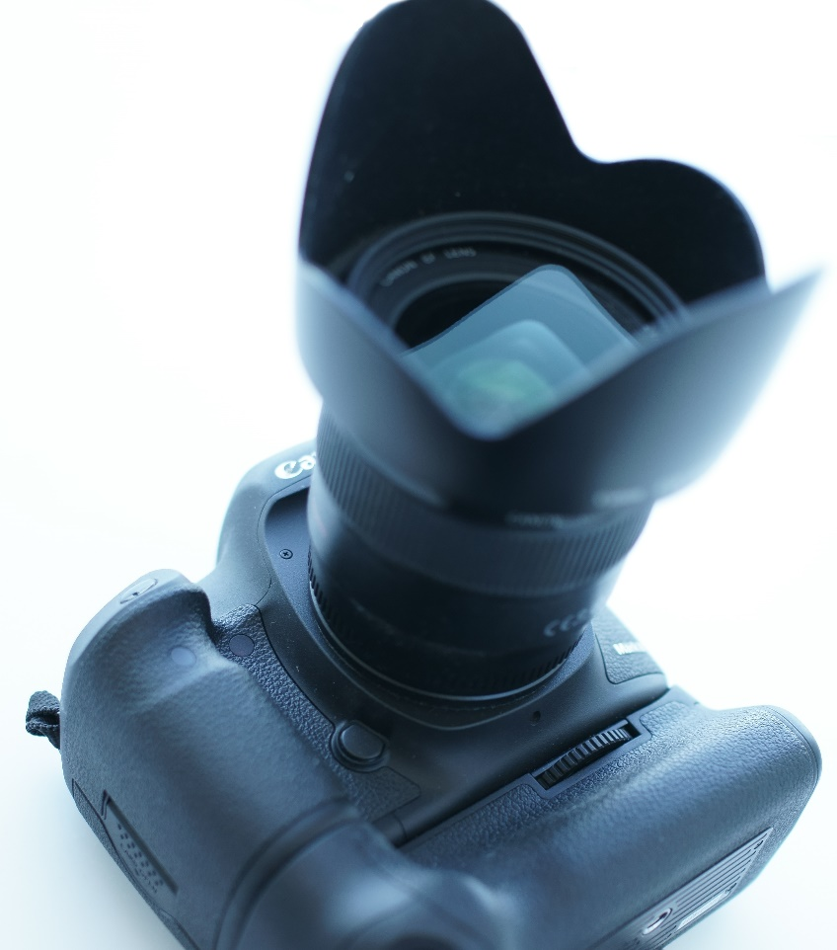
Camera
A camera is made from a lot of components
This course deals with components that make visual differences

Slide 3
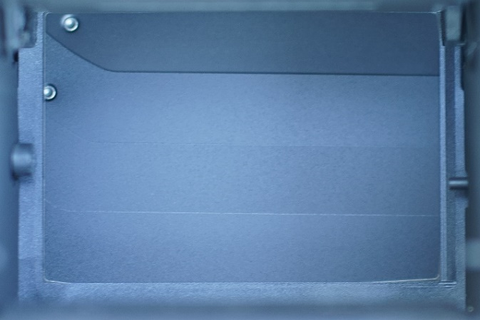
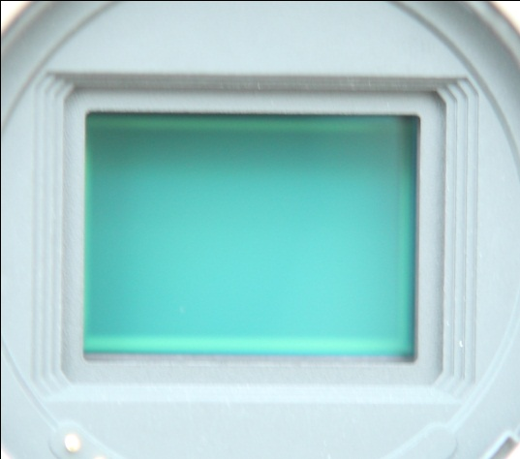
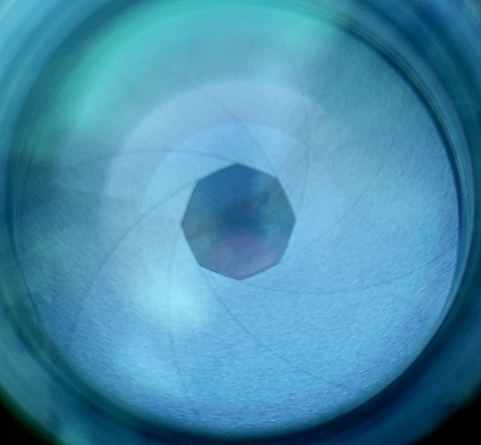
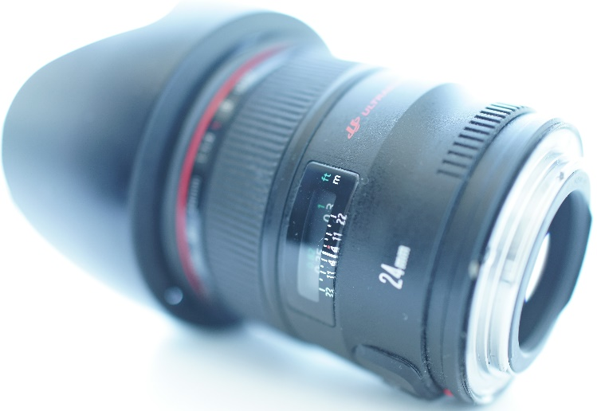
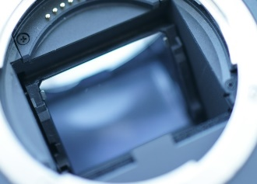
Camera Components
Body
Shutter
Sensor
Lens
Optical lenses
Aperture
Barrel

Slide 4
Exposure
Proper exposure
When you take an image with a camera
Proper exposure (brightness) is required
Need to control multiple factors
Time value (shutter speed)
F-number (aperture)
Film speed (sensor sensitivity)

Slide 5
Exposure Value and APEX
A value for ‘exposure’
To combine ‘time value’ and ‘F-number’
$$E_{v}={\text{log}}_{2}\frac{A^{2}}{T}={\text{log}}_{2}\frac{BS_{x}}{K}$$
$$APEX=A_{v}+T_{v}=B_{v}+S_{v}$$
$A$ : F-number
$T$ : Exposure time (shutter speed)
$B$ : Average scene luminance (brightness)
$S_{x}:$ ISO arithmetic film speed
$K$ : Reflected-light meter calibration constant
$\text{N}\text{ :}$Constant that establishes the relationship between $S_{x}$ and $S_{v}$
$$A_{v}={\text{log}}_{2}A^{2}$$
$$T_{v}={\text{log}}_{2}\left(\frac{1}{T}\right)$$
$B_{v}$=${\text{log}}_{2}\left(\frac{B}{NK}\right)$
$$S_{v}={\text{log}}_{2}\left(NS_{x}\right)$$

Slide 6
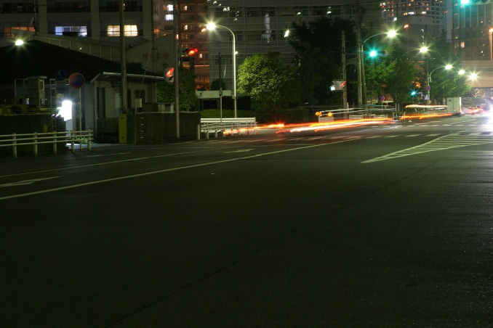
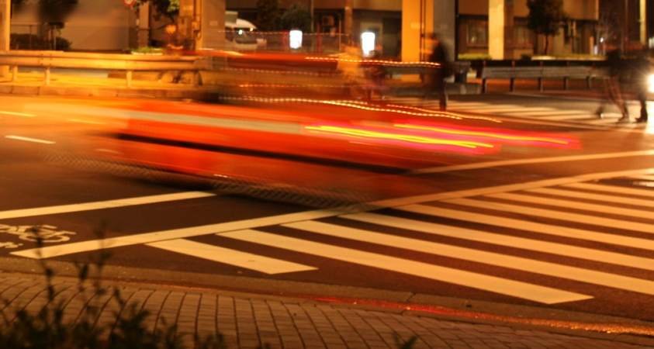
Shutter
A device that allows light to pass for a determined period of time (exposure time)
Mechanical or electrical
Controls exposure (brightness of an image)
Longer exposure time produces longer motion blur

Slide 7
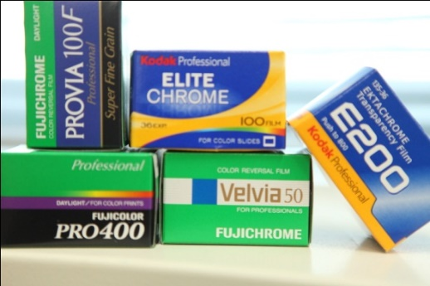
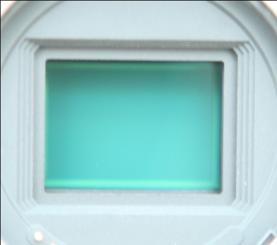
Sensor
To receive photons and convert into electrical signals
Photographic film was used in the past
Higher (ISO) sensitivity yields more noise
Exposure setting affects the amount of noise

Slide 8
Noise vs. Sensitivity
ISO100
400
1,600
6,400
12,800
25,600
51,200
102,400

Slide 9
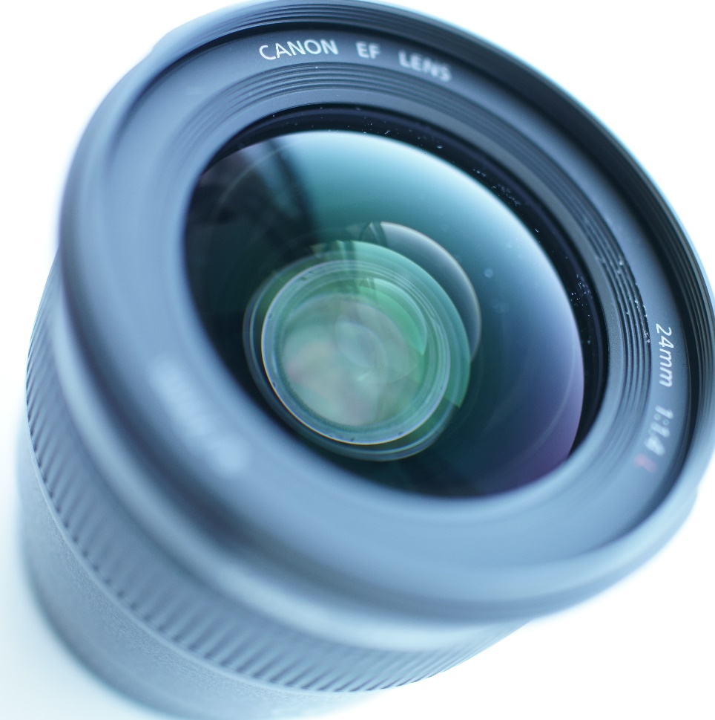
Camera Lens
The main part of this course
A camera lens has:
Multiple optical lenses
An aperture
A barrel
Motors

Slide 10
Optical Lens
Transmissive optical device that affects the focus of a light beam through refraction
Lens is necessary to collect light to acquire an image with the required exposure

Slide 11
Camera Lens Requirements
A camera lens needs
Variable focus distance from close to infinite
Fast exposure (small F-number)
Zoom (optional)
Image stabilization (optional)

Slide 12
Camera Lens Requirements
Multiple optical lenses are necessary to satisfy the requirements
Multiple lenses cause optical side effects
Distortion
Aberrations
More lenses are required to remove side effects
Not perfect with a reasonable number of lenses

Slide 13
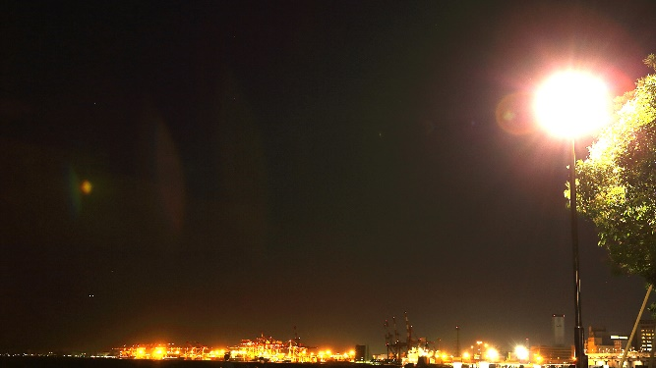
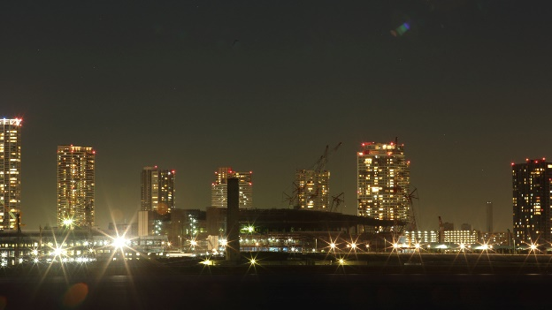
Optical Effects
Physical and optical limitations yield various optical effects
Bokeh
Aberration
Glare (diffraction)
Vignetting
Anamorphic lens effects
Distortion
Ghost

Slide 14
Bokeh
Produced by optical lenses and an aperture
The aperture mechanism produces different shapes of bokeh
Multiple lenses yield various aberrations which produce different appearances of bokeh

Slide 15
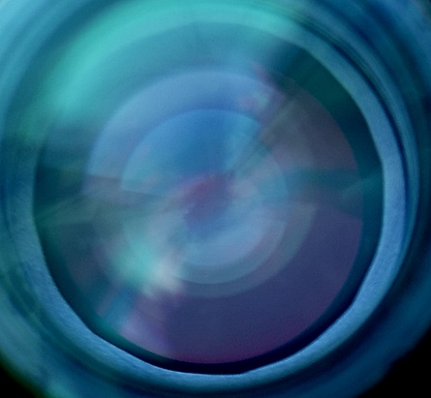
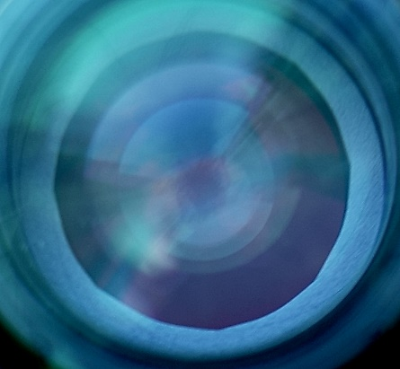
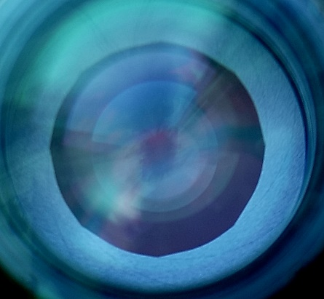
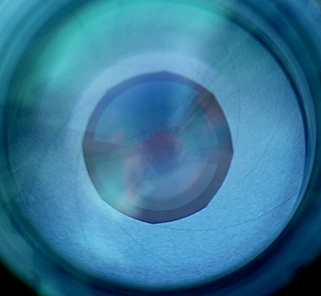
Iris Diaphragm
Camera has an iris diaphragm for an aperture
It typically has multiple blades to control exposure
Curved blades are often used (circular aperture)
Cheaper systems use straight blades or fixed diaphragm
Curved blades yield more complex optical behavior

Slide 16
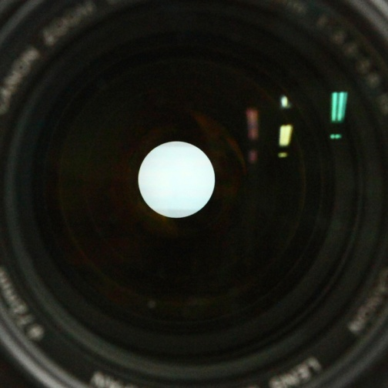
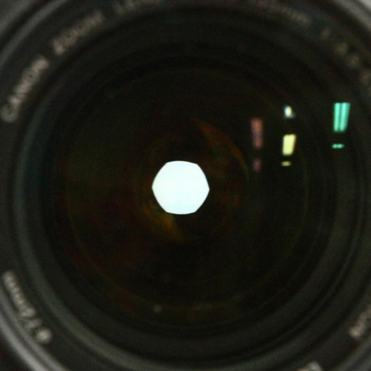
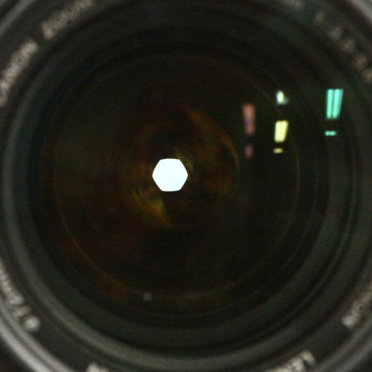
Circular Aperture
The shape of aperture is…
More circular when opened
Tends towards a polygonal shape as it is closed
f/5.6
f/8.0
f/13
Fully opened

Slide 17
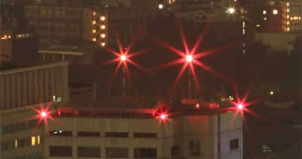
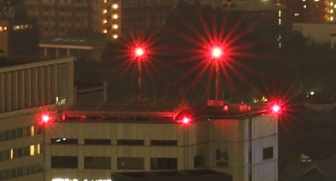
Glare Shape
Glare effect varies by the number of blades
Even numbers of blades produce the same number of spikes (8 blades)
Odd numbers of blades produce twice the number of spikes (9 blades)

Slide 18
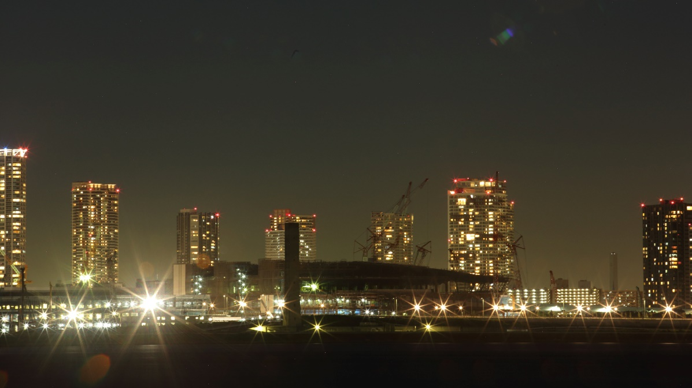
Glare Shape
Circular aperture produces more complex glare effects

Slide 19
Glare Shape and F-number
Shorter and thinner
Longer and thicker
f/2.8
f/3.2
f/3.5
f/4.0
f/5.6
f/8.0
f/11
f/16
f/22

Slide 20
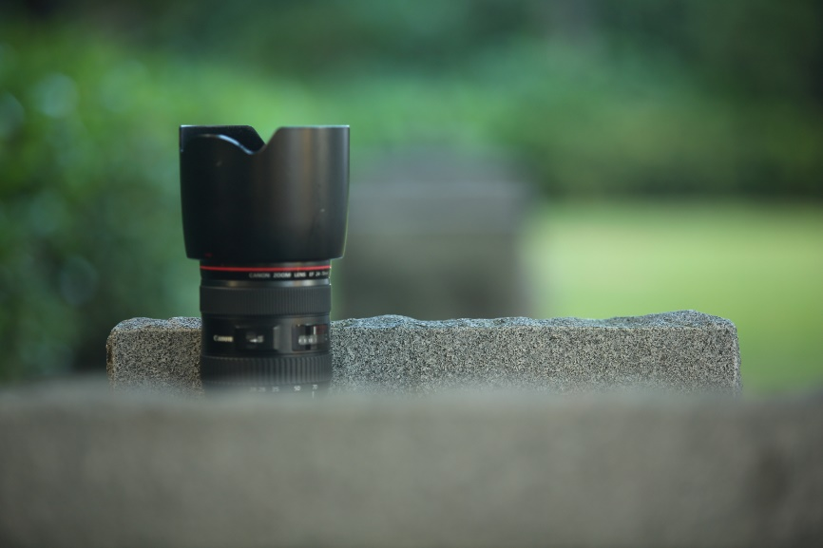
Depth of Field
F-number also controls depth of field
The nearest and farthest objects in a scene that appear acceptably sharp in an image

Slide 21
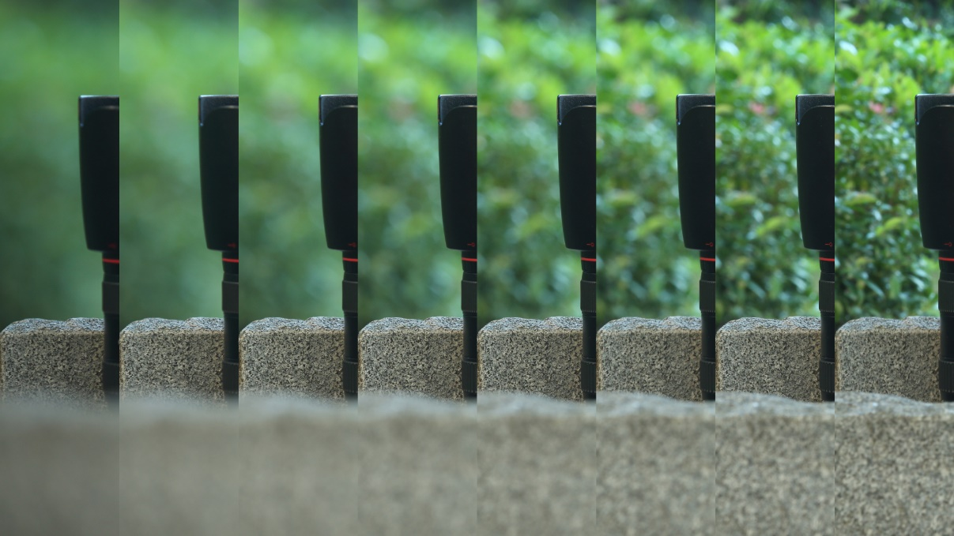
Depth of Field and F-number
f/2.8
f/4.0
f/5.6
f/8.0
f/11
f/16
f/22
f/32

Slide 22
Focus and View Angle
Changing focus distance optically causes view angle (focal length) variations (focus breathing)
The theoretical reason will be explained later
Easily recognizable view angle difference
This lens can focus between 1.5m and Inf. Even with a 30cm focus distance change as shown in these pictures, recognizable view angle change appears.
Focus on this glass

Slide 23
Focus Breathing
When focusing on a closer point, field of view gets narrower

Slide 24
Focus Breathing

Slide 25
Aberrations
Multiple optical lenses yield a variety of different aberrations
Spherical Aberration
Coma
Field Curvature
Oblique Astigmatism
Distortion

Slide 26
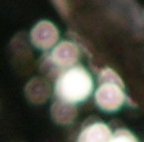
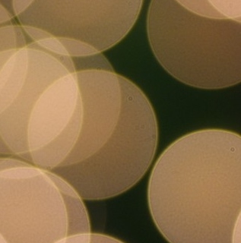
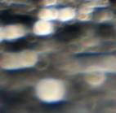
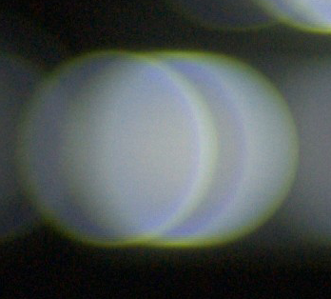
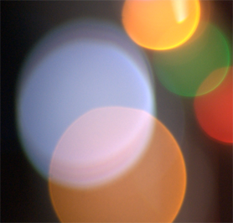
Aberrations
Different configurations of multiple lenses produce a variety of bokehs
Pictures from [Kawase 2012]

Slide 27
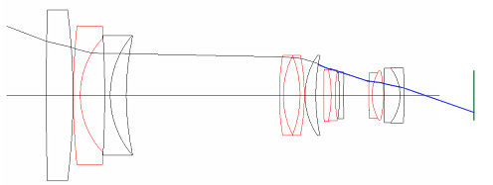
Optical Vignetting
Phenomenon that light entering near the edge of the lens at an obtuse angle can’t reach the sensor
Because it is obstructed by the lens barrel
The actual physical phenomenon is very complicated
Blue line indicates that ray is obstructed
Sensor

Slide 28
Optical Vignetting
24mm F2.8
Recognized as…
The corners of the picture are darkened
“Cat eye effect” (eclipsed bokeh)
24mm F5.6

Slide 29
Anamorphic Lens
Legacy lenses that are designed for film
To make full use of the available film, a lens is used during photography to stretch the image vertically
Effects caused by the lens make the picture “retro.”
Recently, some (Sci-fi) films or games use anamorphic lens effects to make them “retro”-style

Slide 30
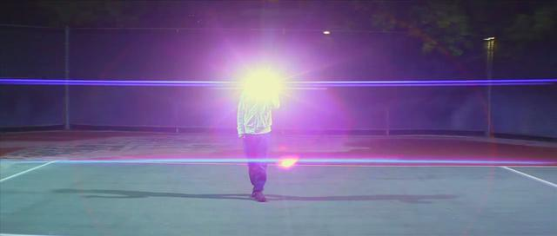
Anamorphic Lens Effects
Panasonic LA7200 Anamorphic Lens Flare by Andrei Jikh
http://vimeo.com/9493224#at=0

Slide 31
Lens Ghosts
Undesired artifacts caused by multiple reflections and refractions in a camera lens
Various shapes of ghosts are observed
Lens opening
Aperture
Vignetting

Slide 32
Lens Ghosts
Emphasized

Slide 33
Effects by Camera Mechanism
 | Exposure | Depth of Field | Bokeh Shape | View Angle | Motion Blur | Noise | Vignetting | Ghosts
Shutter | x |  |  |  | x
Sensitivity | x |  |  |  |  | x
Zoom | (x) | x | (x) | x |  |  | x | x
Focus | x | x | (x) | x |  |  | x | x
Aperture | x | x | x |  |  |  | x | x

Slide 34
Conclusion
A camera has multiple factors to take an intentional image
Changing a factor to control a parameter always has side effects

Slide 35
Acknowledgements
Masaki Kawase
Masanori Kakimoto
Kristian Spoerer

