Slide 1
Basic Implementation of Bokeh Real-time Rendering of Physically Based Optical Effects in Theory and Practice Yoshiharu Gotanda tri-Ace, Inc.

Slide 2
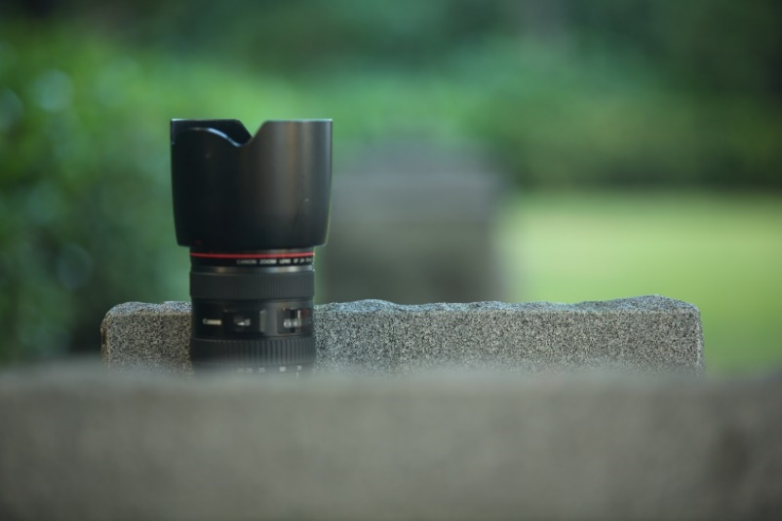
Bokeh
One of the most important optical effects
Adds the appearance of “depth” to the image
Beautiful bokeh is important for image quality

Slide 3
Scatter or Gather?
Scatter-based algorithms are theoretically easier for implementing bokeh
Better quality
Brute-force implementation is much more computationally expensive
Need many hacks for reasonable performance

Slide 4
Scatter or Gather?
Gather-based algorithms can more easily improve performance
For lower or older hardware
Mipmap techniques
A lot of hacks are necessary
Masking for color bleeding
Layering approach

Slide 5
Basic Implementation
Blur each pixel to the shape of the aperture based on:
Depth
Camera parameters
The biggest difference is the filtering algorithm between gather and scatter-based approaches
The basic implementation is the same

Slide 6
Mipmap Techniques
Larger bokeh requires many taps
For shallower depth of field
Using lower resolution textures for larger bokeh is useful to leverage performance

Slide 7
Mipmap Techniques
More correct blur radius
Smoother but less correct
Different source texture LodBias, same tap count

Slide 8
Mipmap Result
58 taps, 1/4 and 1/16 reduced buffers 1.9ms @ 1920x1080 on PlayStation 4
Mipmap Comparison

Slide 9
130 taps, 1/4 and 1/16 reduced buffers 3.2ms @ 1920x1080 on PlayStation 4
Mipmap Comparison

Slide 10
Back 228 taps, Front 134 taps, 1/4 and 1/16 reduced buffers 4.0ms @ 1920x1080 on PlayStation 4
Mipmap Comparison

Slide 11
58 taps, 1/4 and 1/16 reduced buffers 1.9ms @ 1920x1080 on PlayStation 4
34 taps, 1/16 and 1/64 reduced buffers 2.54ms @ 1280x720 on PlayStation 3
Multi-platform Comparison

Slide 12
130 taps, 1/4 and 1/16 reduced buffers 3.2ms @ 1920x1080 on PlayStation 4
22 taps, 1/4 and 1/16 reduced buffers 4.53ms @ 1280x720 on PlayStation 3
Multi-platform Comparison

Slide 13
Back 228 taps, Front 134 taps 1/4 and 1/16 reduced buffers 4.0ms @ 1920x1080 on PlayStation 4
34 taps, 1/4 and 1/16 reduced buffers 5.81ms @ 1280x720 on PlayStation 3
Multi-platform Comparison

Slide 14
Focus Breathing
As mentioned earlier, focus distance affects the effective F-number
Field of view
Exposure

Slide 15
Computing Effective F-number
Update the field of view and the exposure based on the effective F-number
$$FOV=2\text{atan}\left(\frac{h\left(d_{o}−f\right)}{2d_{o}f}\right)$$
$$F_{e}=\left(\frac{d_{i}}{f}\right)F$$
$h :$Size of the sensor
$d_{o} :$Focus distance
$d_{i } :$ Distance from the lens to the sensor
$f :$ Focal length
$F :$ F-number

Slide 16
135mm f/20
(No Effective F-number)

Slide 17
135mm f/20
(Effective F-number 22.5)

Slide 18
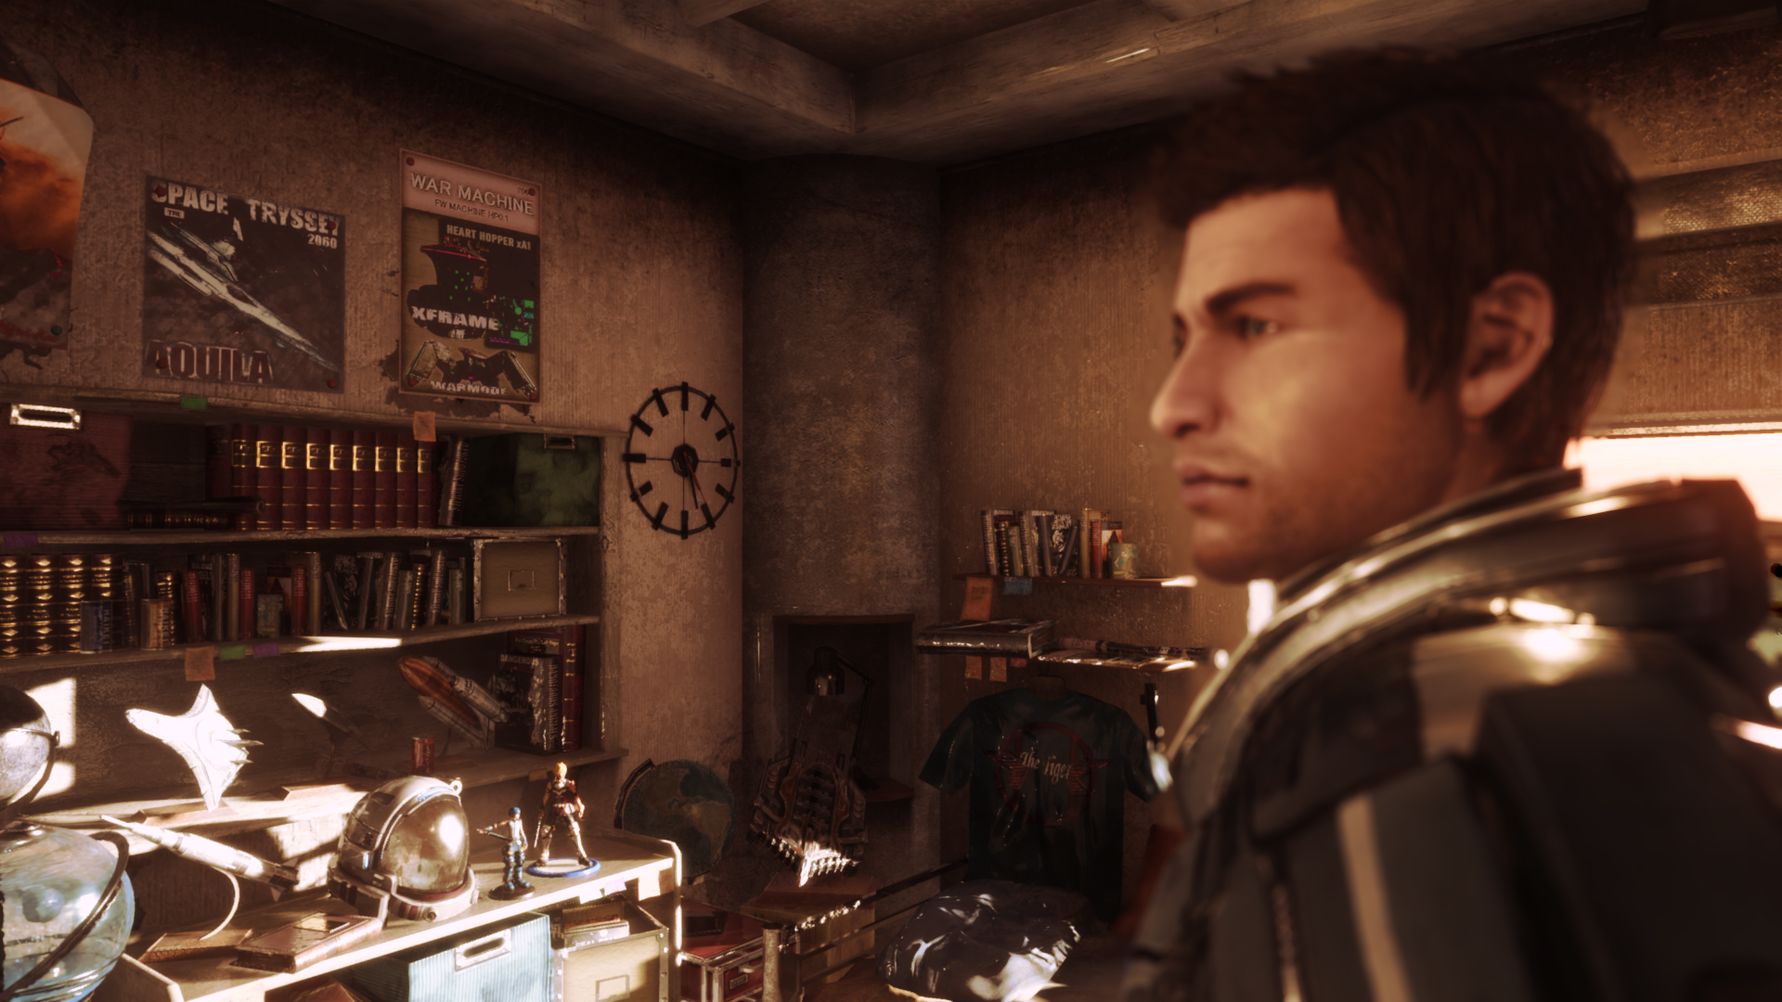
Result of Focus Breathing
24mm, f/5.6, Focus Distance : Inf.

Slide 19
Result of Focus Breathing
24mm, f/5.6, Focus Distance : 42cm

Slide 20
Results
Result of Focus Breathing
28mm, f/5.6, Focus Distance : 37cm
Under development
© SQUARE ENIX CO.,LTD. All Rights Reserved. Developed by tri-Ace Inc. CHARACTER DESIGN : akiman

Slide 21
Result of Focus Breathing
28mm, f/5.6, Focus Distance : 2.7m
Under development
© SQUARE ENIX CO.,LTD. All Rights Reserved. Developed by tri-Ace Inc. CHARACTER DESIGN : akiman

Slide 22
Accurate CoC
Circle of Confusion (the diameter of bokeh) can be calculated with:
$$CoC\left(z\right)=\left(\frac{d_{o}f}{d_{o}−f}−\frac{zf}{z−f}\right)\frac{D\left(z−f\right)}{zf}$$
$d_{o} :$Focus distance
$z :$ Distance from the lens to the subject
$f :$ Focal length
$D :$ Diameter of the aperture

Slide 23
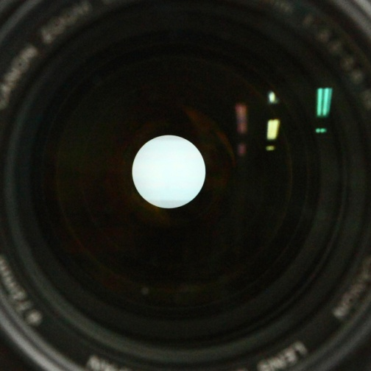
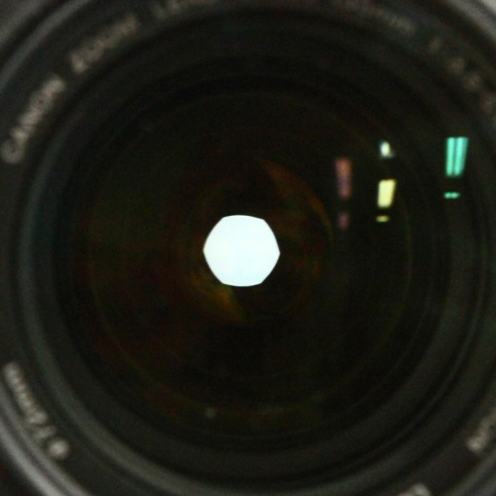
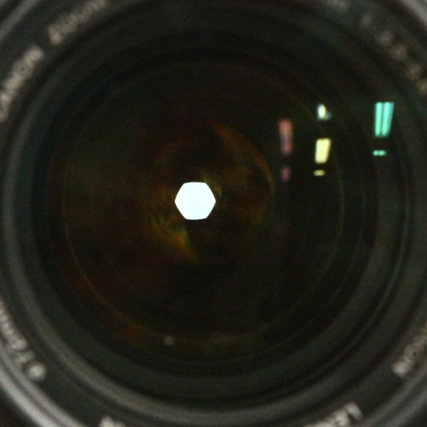
Bokeh Shape
A typical camera has a circular aperture
Not a simple polygon
Not a simple circle

Slide 24
Implementation
Very simple approach
Change the blur filter shape w.r.t. the ratio of the given F-number to the minimum F-number

Slide 25
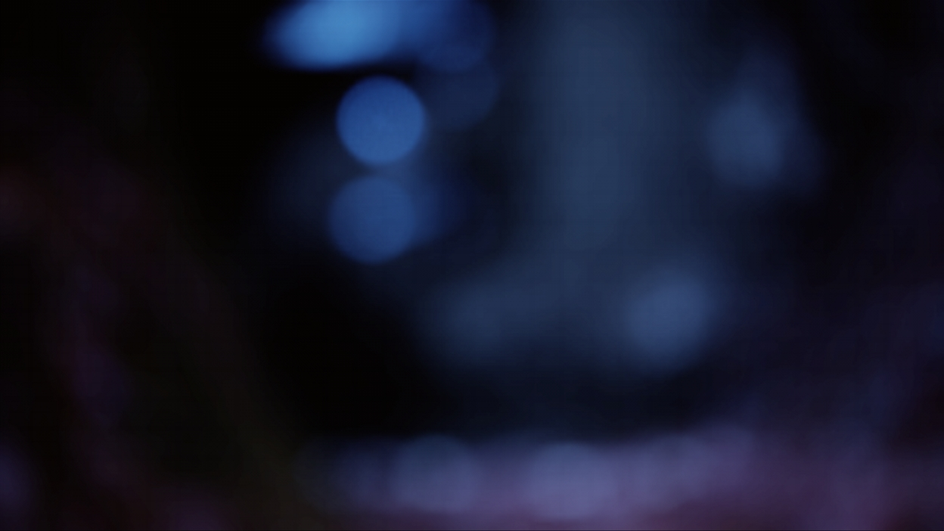
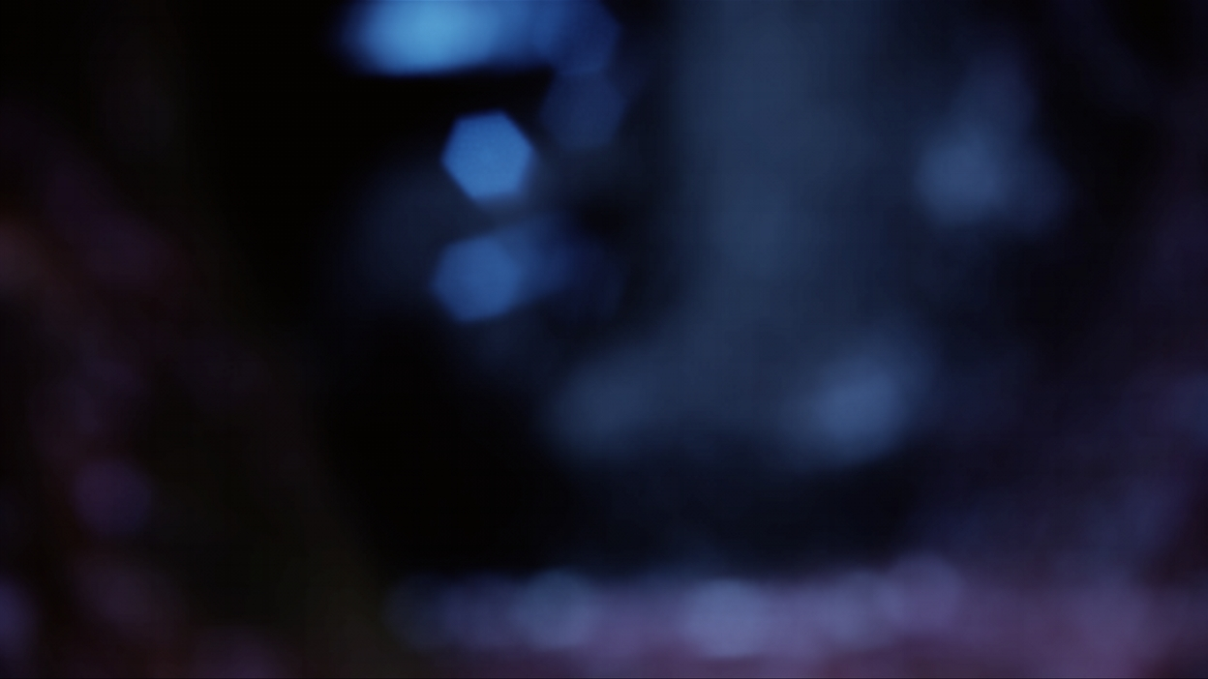
Results
100mm 1/250 f/4.3 (our simulation)
28-200mm F3.5-5.6 (6 blades)
(91taps)
100mm 1/30 f/12.5 (our simulation)

Slide 26
Comparison
A light source of 5mm in diameter at a distance of 3m from the camera
The focus distance is 1.5m, with 70-200mm F2.8 lens at 200mm
Real photo
f/2.8 f/3.2 f/3.5 f/4 f/5.6
Our simulation

Slide 27
Comparison
Real photo
f/8 f/11 f/16 f/22 f/32
Our simulation

Slide 28
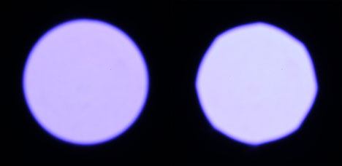
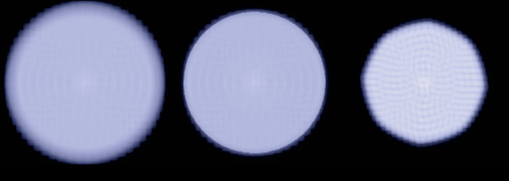
One More Thing
Real Photo f/2.8 & f/3.5
During the experiment, the difference in size between f/2.8 and f/3.5 in the real photo is smaller than the theoretical calculation
Actually, bokeh at f/2.8 is optically vignetted
f/2.8 (without vignetting simulation)
f/2.8
f/3.5

Slide 29
Optical Vignetting
Optical vignetting occurs due to limitations of lens design
Under specific conditions, bokeh is eclipsed
Very complicated phenomenon

Slide 30
Optical Vignetting
Vignetting occurs at different points
Vignetting simulation with a camera lens (Dash line indicates that a ray is occluded)

Slide 31
Implementation
Difficult to perfectly simulate a camera lens
Ray-tracing is needed
Too computationally expensive for real-time
LUT with precomputation is required
High dimensionality
Proper lens design is needed
Zoom, focus and aperture mechanisms must be simulated accurately

Slide 32
Implementation
Approximate lens design
Lens database
Optical vignetting occurs by optical limitations
Physically-plausible simulation is necessary
Otherwise, unnatural vignetting occurs
Easiness of optical vignetting occurrence differs by camera lenses
Moreover, it depends on given lens parameters

Slide 33
Approximated Lens Database
Parameters required for vignetting sim.
Design parameters
Estimated lens barrel position and radius which most likely cause optical vignetting
The aperture position and radius
The length of back focus or flange focal distance
Camera parameters
Effective F-number

Slide 34
Vignetting Shader
Compute vignetting in pixel shader with the lens database
True ray-tracing is too expensive
Ray is approximated by a line from the focus point to the aperture
Compute occlusion with the projected aperture and lens barrel
Projected lens barrel causing optical vignetting (from the lens database)
Vignetted bokeh
Original (not vignetted) bokeh, projected aperture

Slide 35
Results
Eclipsed bokeh

Slide 36
Results
Front bokeh
Back bokeh
Eclipse directions are opposite for front and back bokeh

Slide 37
Vignetting
Reduction of an image’s brightness at the periphery compared to the image center
Reduction by optical vignetting
Bokeh converges on one pixel at focus points
Reduction by natural vignetting
Cosine Fourth Law

Slide 38
Reduction by Optical Vignetting
Eclipsed bokeh area attenuates brightness
Area of vignetted bokeh can be calculated using the same lens database
The area of two circles overlapped
The result is used in the shader to attenuate the brightness

Slide 39
Reduction by Natural Vignetting
Image projection is governed by Cosine Fourth Law
Amount of light is reduced by following cos⁴ (angle of view)
Real camera lenses reduce this effect by increasing aperture ratio at the edges of the lens
As a result, natural vignetting doesn’t follow cos⁴ (typically cos^{2~3})
Natural vignetting isn’t improved even with bigger F-numbers
This phenomenon always occurs
Especially noticeable with wide-angle lenses

Slide 40
Cosine Fourth Law
Attenuation ratio with a small F-number (F5.6) (Attenuation by mostly Cosine Fourth Law)
Attenuation ratio with the minimum F-number (F2.8) (Attenuation by Cosine Fourth Law and optical vignetting)
Attenuation ratio of a camera lens for 35mm camera system (f=25mm)

Slide 41
Results of Vignetting
Vignetting at corners is reduced with bigger F-numbers, but natural vignetting still remains regardless of F-number
Simulated at F5.6
Simulated at F2.8

Slide 42
Conclusion
It is important to follow the mechanisms of a real camera
To achieve photo-realistic optical effects
Bokeh isn’t just blur

Slide 43
Acknowledgements
Masaki Kawase
Masanori Kakimoto
Tatsuya Shoji
Kazuhiro Nagano
Kristian Spoerer

