Slide 1
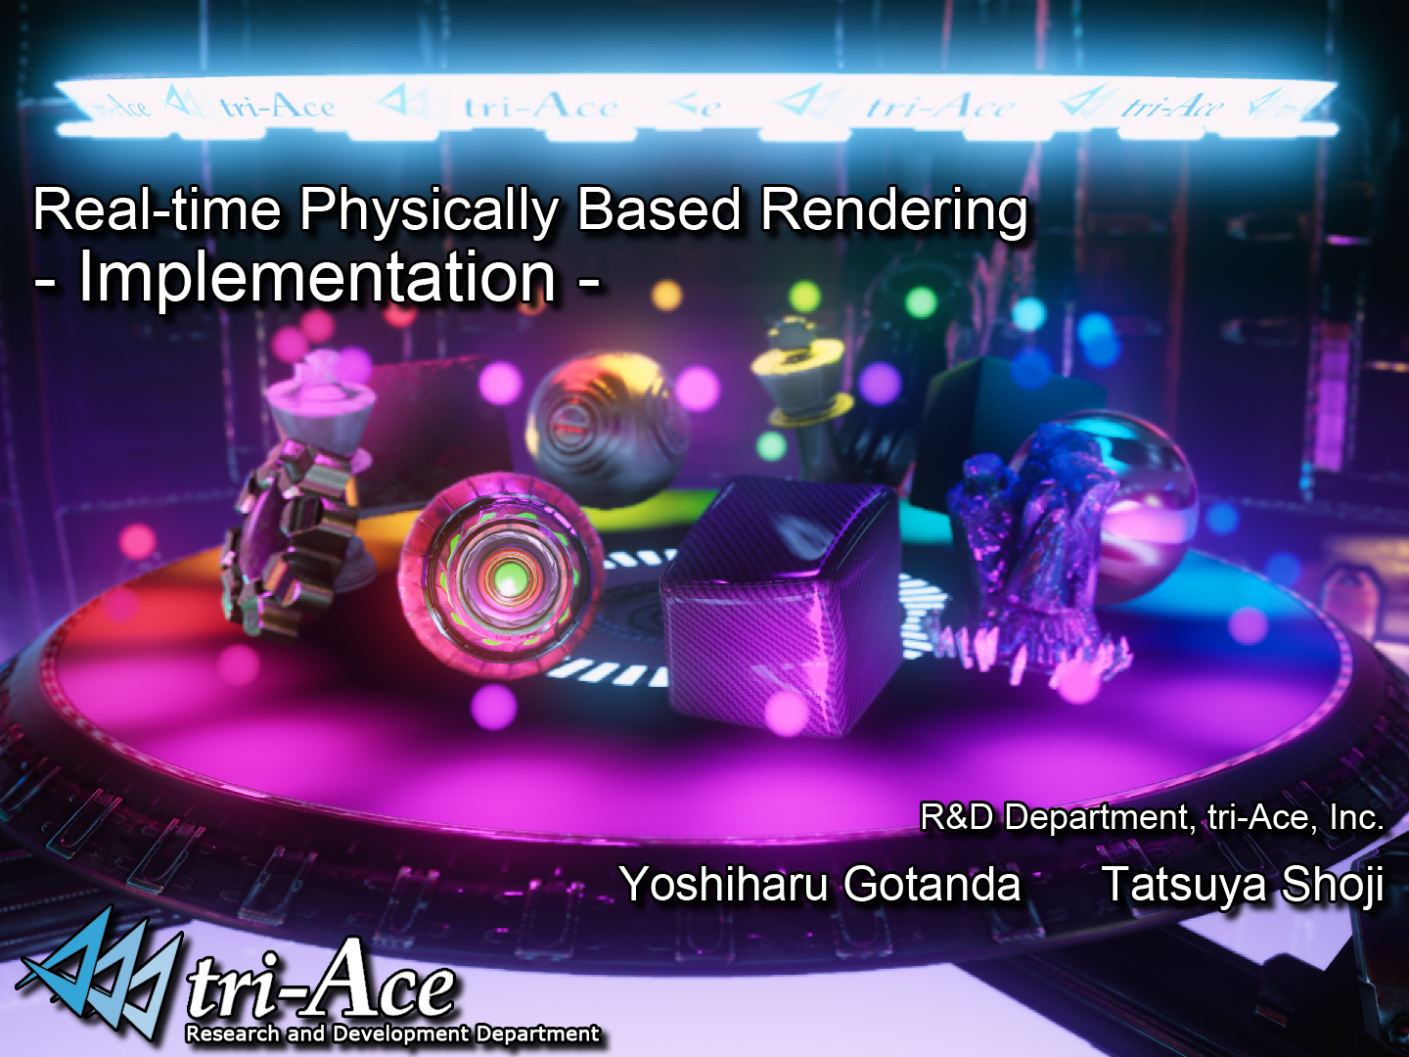

Slide 2
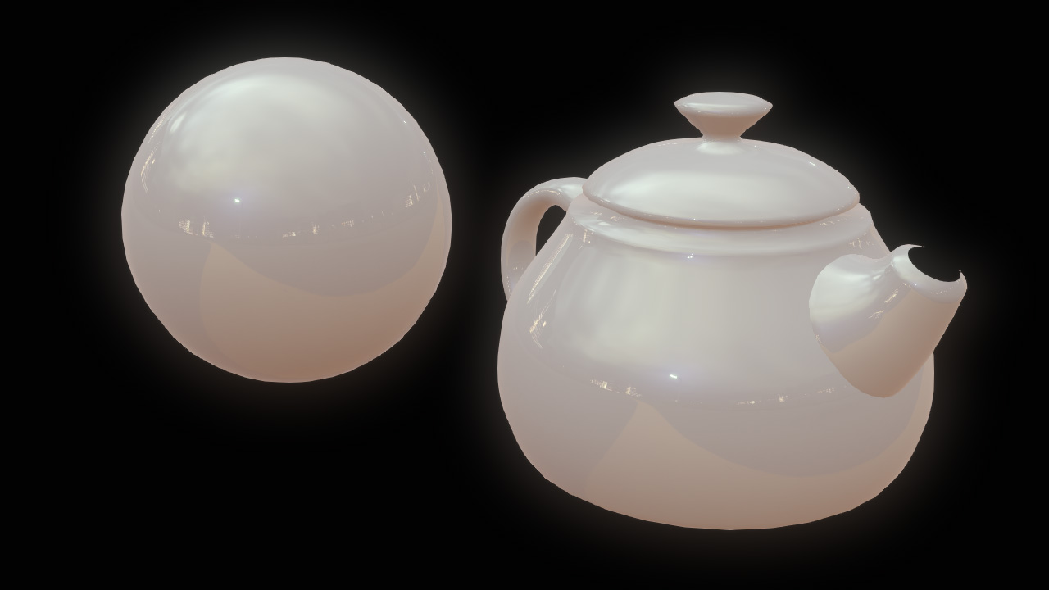
Image Based Lighting (IBL)
Lighting that uses a texture (an image) as light source
  How is it different than Environment Mapping?
    In a broad sense, environment mapping is one of techniques of Image Based Lighting

Slide 3
Physically Based IBL
Ad-hoc IBL vs. Physically-based IBL
  Has the same differences and similarities between ad-hoc rendering and physically based rendering
  Ad-hoc rendering
    Each process needed for rendering is implemented one by one, ad-hoc
  Physically Based Rendering
    The entire renderer is designed and built based on physical premises such as the Rendering Equation and etc.

Slide 4
Physically Based IBL advantages
Guarantees a rendering result that is close to shading under punctual light sources
  Materials in a scene dominated by direct lighting and indirect lighting seem the same
    Consistency is preserved through different lighting
    Artists spend less time tweaking parameters
    Even in a scene dominated by indirect lighting, materials look realistic
    No need to use an environment map for glossy objects
      Just add an IBL light source

Slide 5

PBIBL implementation
Implementing IBL as an approximation of the rendering equation
  Physically Based Image Based Lighting is one of possible examples to reasonably implement physically based rendering

Slide 6
Equations
substitute

Slide 7
Decompose integral
Irradiance Environment Map (IEM)
Pre-filtered Radiance Environment Map
(PFREM)
AmbientBRDF Volume Texture

Slide 8

Implement Ambient BRDF
Precompute this equation off line and store result to a volume texture
  U – Dot product of eye vector (ω) and normal (n)
  V – shininess
  W – F₀

Slide 9
AmbientBRDF texture usage
Fetch the texture
  For specular component
    Use the value for
  For diffuse component
    R_{d}*(1 – the value)
      For optimization
    Ideally values for diffuse component should be precomputed and stored to the texture for accurate shading

Slide 10


AmbientBRDF comparison
AmbientBRDF ON
AmbientBRDF OFF

Slide 11
Generate textures
Use AMD CubeMapGen?
  It can't be used for real-time processing on multi-platform, because it is released as a tool / library

Slide 12
Generate textures
Use AMD CubeMapGen?
  It can't be used for real-time processing on multi-platform, because it is released as a tool / library
  Even so, the quality is not perfect and there is room for improvement
But it has become open-source ☺

Slide 13

Generate IEM
Implement this equation straightforwardly on GPU
  Diffuse BRDF is Lambert
    In the case of IBL, the use of other models doesn't bring any significant differences
      Strictly speaking, it depends of the intensity distribution in an IBL image
  Texture resolution is 16x16x6

Slide 14
Generate IEM (2)
Using a radiance map reduced to 8x8x6
  Store accurately precomputed Δω to the texture using spherical quadrilateral
    AMD CubeMapGen uses approximated Δω
  Normalizing coefficient is also stored in the texture
  Fp16 format
  8x8x5 = 320tap filter on GPU
    Xbox360 0.5ms
    PS3 2.0ms
      Would be better on SPU

Slide 15
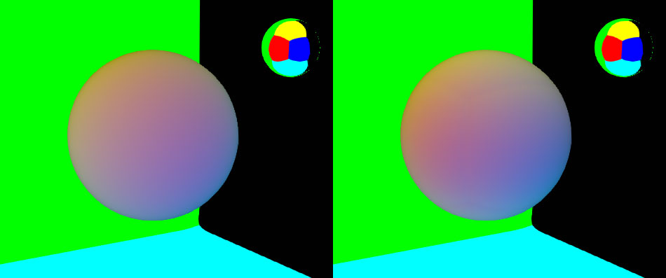
Optimize diffuse term
Using SH lighting instead of IEM for a high performance configuration
  Our engine already implements SH lighting
    No extra GPU cost
  Compute the coefficients from 6 texels at the center in each face
Spherical Harmonics
Irradiance Map

Slide 16
Generate REM
Pre-filtered Mipmapped Environment Map
  Compute the equation with different shininess values and store results to each mipmapped texture
  Blinn based NDF?
    Approximated with Phong
      This is a compromise solution because the specular highlight shape changes due to different microfacet models
    Only fitting the size difference of NDFs using shininess

Slide 17
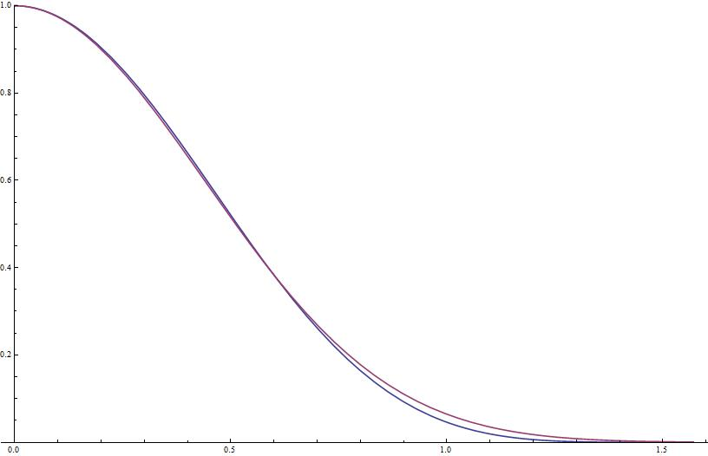
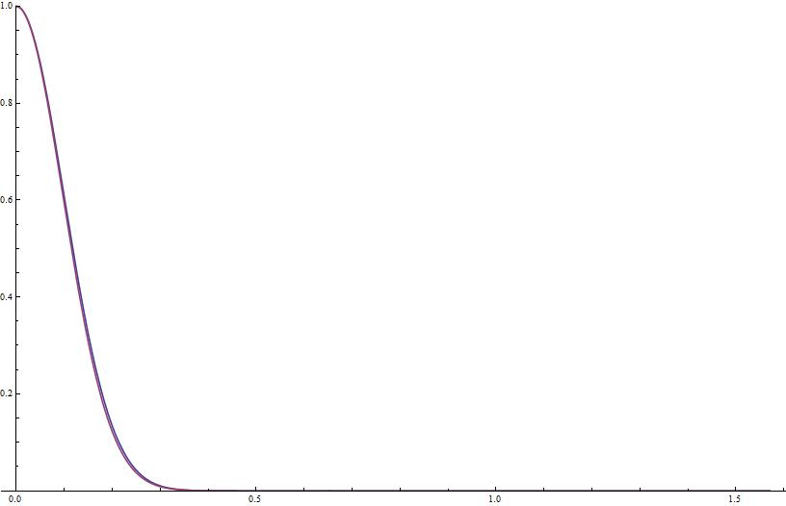
Fitting shininess
shininess = 5
shininess =100

Slide 18
Generate PMREM (1)
Box-filter kernel filtering
  Simply use bilinear filtering to generate mipmaps
  LOD values are set according to shininess
    Quality is quite low
    Not even an approximation
  Use as a fastest profile for dynamic PMREM generation

Slide 19
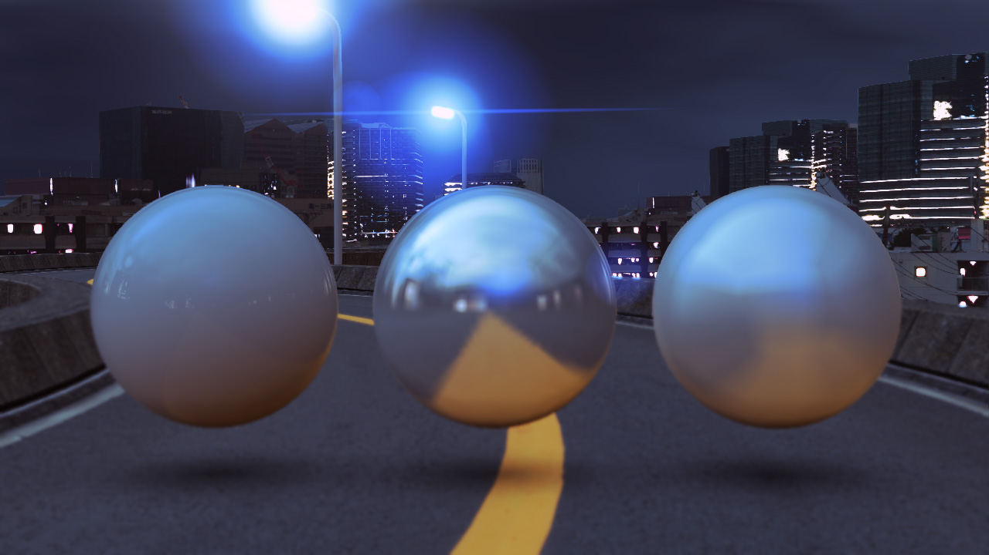
Box kernel filter

Slide 20
Generate PMREM (2)
Gaussian kernel filtering
  Apply 2D Gaussian blur to each face
    Not physically based
      As the blur radius increases, visual artifacts from error in Δω become noticeable
    The cube map boundary problem is noticeable
      Even using overlapping (described later) for slow gradation generated by the blur process, since filtering isn’t performed over edges, banding is perceived on the edges when colors are changed rapidly
    Use as the second fastest profile for dynamic PMREM generation

Slide 21
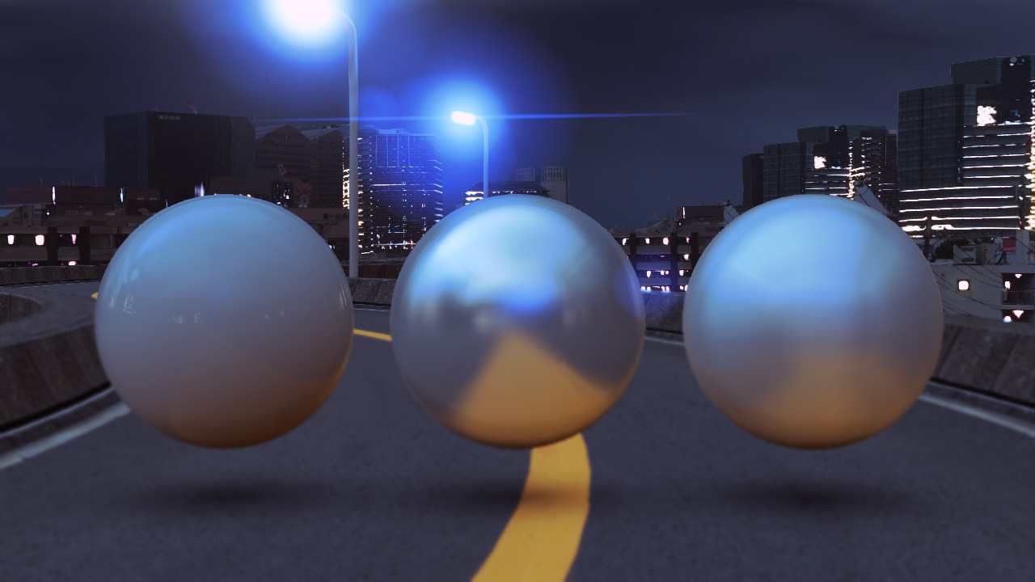
Gaussian kernel filter

Slide 22
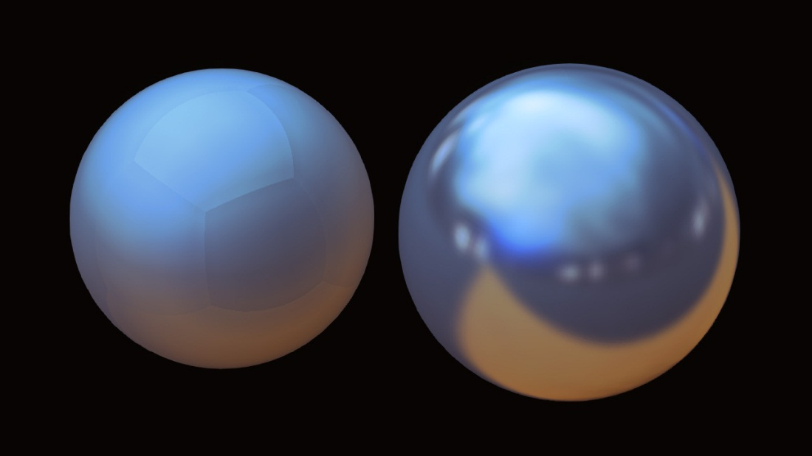
Generate PMREM(3)
Spherical Phong kernel filtering
  The shininess values are converted using the fitting function
  The cube map boundary problem still exists
    We expected to solve it before the implementation
    The reason is that, since the centers of adjacent pixels across the edges are not matched, the filtered colors are also not matched

Slide 23

Spherical Phong kernel filter

Slide 24
Phong kernel implementation(GPU)
Brute force implementation similar to irradiance map generation
  In the final implementation, a face is subdivided into 9 rectangles for texture fetch reduction
    Faster by 50%
    9x6=54 shaders are used for each mip level
  Subdivision is not used below 16x16
    It becomes ALU bound as texture cache efficiently works for smaller textures

Slide 25
Phong kernel implementation(CPU)
Offline generation by the tool for static IBL
  SH coefficients and PMREM are automatically generated during scene export
    For performance, 64x64x6 PMREM is only supported for static IBL
    Brute force implementation
      All level mipmaps are generated from the top level texture at the same time
    Core2 8 hardware threads @ 2.8GHz
      64x64x6 : 5.6s
      32x32x6 : 0.5s
      SSE & multithread

Slide 26
Generate PFREM (4)
Poisson kernel filtering
  Implemented a faster version of Phong kernel filtering
    Apply about 160tap filter with one lower level mipmap texture
      Quality is compromised even with this process
    Many taps are needed for desired quality
      Didn’t work as optimization
      Didn’t work well with Overlapping process
    Not used because of bad quality and performance

Slide 27


Comparisons
Box kernel filter
Gaussian kernel filter
Spherical Phong kernel filter
Spherical Phong kernel filter

Slide 28
Mipmap LOD
Mipmap LOD parameter is calculated for generated PMREM
  Select the mip level according to shininess
    Using texCUBElod() for each pixel
      a is calculated according to the texture size and shininess
    With trilinear filtering
  Each shininess value corresponding to each mip level is calculated by fitting
    Fitted for both Box Filter Kernel and Phong Filter Kernel

Slide 29
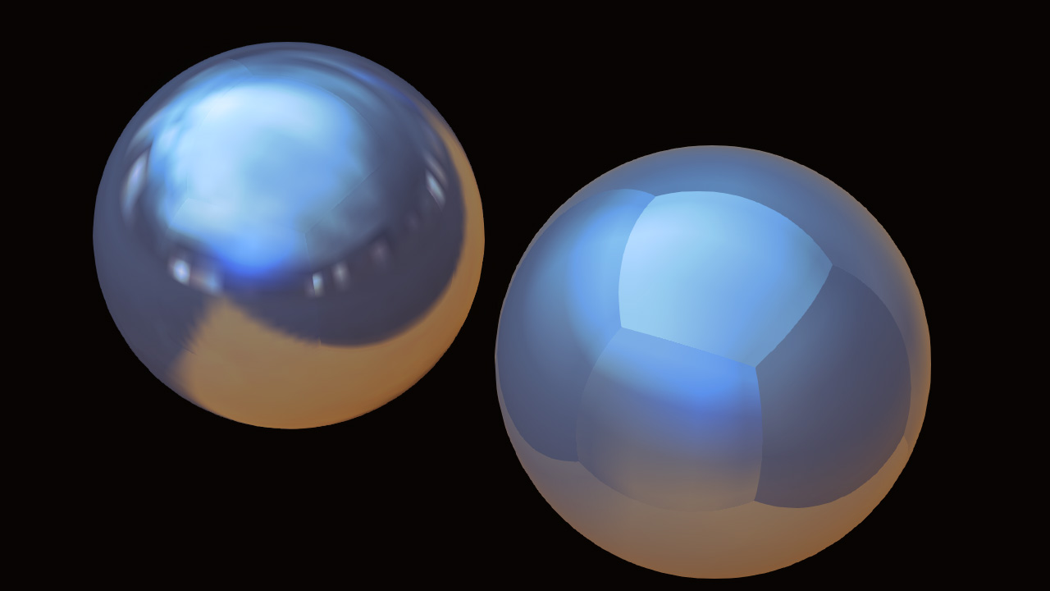
Edge overlapping
Need to solve the cubemap boundary problem
  No bilinear filtering is applied on the cubemap boundaries of each face with DX9 hardware
  Problematic especially for low resolution mipmaps (1x1 or 2x2)
  Edge fixup in AMD CubeMapGen

Slide 30
Edge overlapping (1)
Blend adjacent boundaries by 50%
  Simplified version of AMD CubeMapGen’s Edge Fixup
    Adjacent texels across the boundaries become the same colors
      If corners, the colors become the average of adjacent three texel colors
      If 1x1, the color becomes the average of all faces
        All texels become the same color
    Banding is still noticeable because color gradation velocity varies

Slide 31
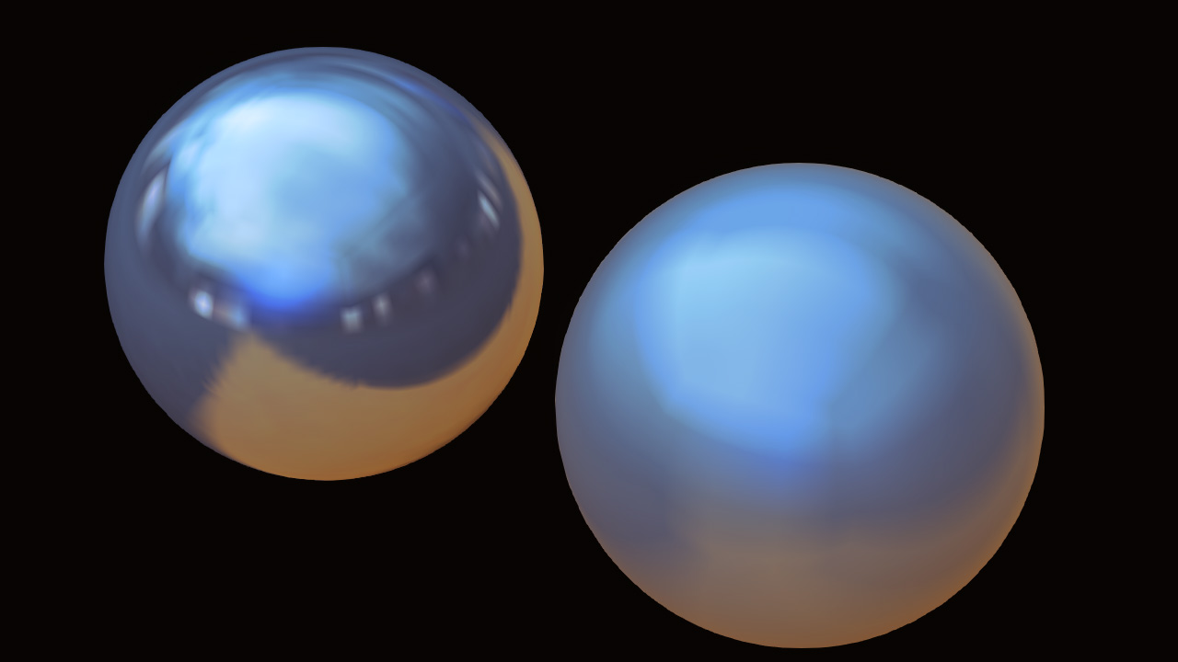
Edge overlapping (1)

Slide 32
Edge overlapping (2)
Blend multiple texels
  For the next step, blend 2 texels
    In order to reduce gradation velocity variation, blend 2 texels by 1/4 and 3/4 ratio
      Same approach as CubeMapGen
      However, banding is still noticeable in the case where gradation acceleration drastically varies
      As the area where banding is noticeable increases, the impression gets worse
      Because the blurred area increases, the accuracy of the integration decreases
        Worse rendering quality

Slide 33
Edge overlapping (3)
4 texel blend?
  More blends don’t make sense according to our research
    4 texel blending in CubeMapGen is not so high quality
    Moreover, the precision as a signal decreses

Slide 34
Bent Phong filter kernel
This algorithm blends normals instead of colors
  Similar to the difference between Gouraud Shading and Phong Shading
The normal from the center of the cube map through the center of the texel is bent by an offset angle
  The offset angle is interpolated from zero at the center of the face to a target angle at the edge
  The target angle is the angle between the two normals of adjacent faces’ edge texels
    The result from just the above steps was improved, but still not perfect
    Then, using only 50% of target angle gave a much better result
In the final implementation, the target angle is additionally modified based on the blur radius
  Large radius : 100% of target angle used
  Small radius : 50% used
  Since optimal values for the target angle are image dependant, adjust the values by visual adjustment instead of mathematical fitting

Slide 35

Bent Phong filter kernel

Slide 36
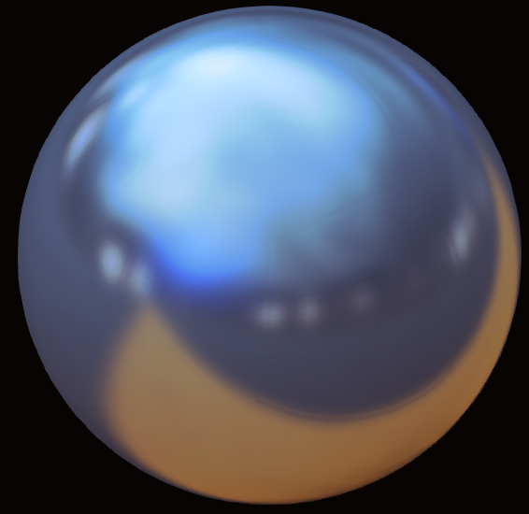
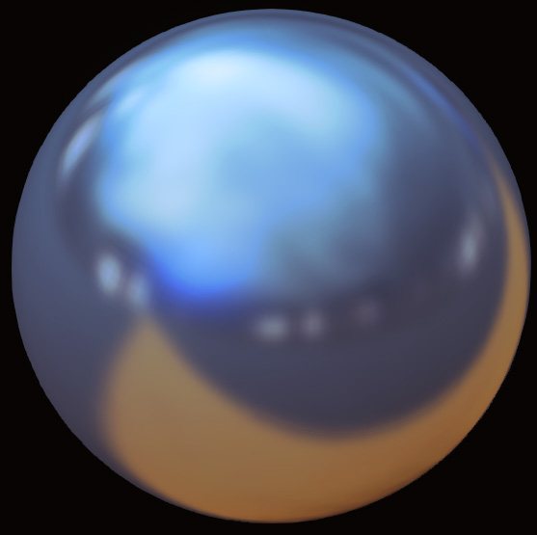
Bent Phong filter kernel
Edge overlapping w/ Phong filter kernel
Bent Phong filter kernel

Slide 37
Implemented configurations
Dynamic IBL
Resolution | Shininess | Filtering | Edge fixup
16x16x6 | 1-500 | None | Edge overlapping
32x32x6 | 1-1000 | 2D Gaussian | Edge overlapping
16x16x6 | 1-250 | Spherical Phong | Bent Phong
32x32x6 | 1-1000 | Spherical Phong | Bent Phong
Static IBL
Resolution | Shininess | Filtering | Edge fixup
32x32x6 | 1-1000 | Spherical Phong | Bent Phong
64x64x6 | 1-2000 | Spherical Phong | Bent Phong

Slide 38
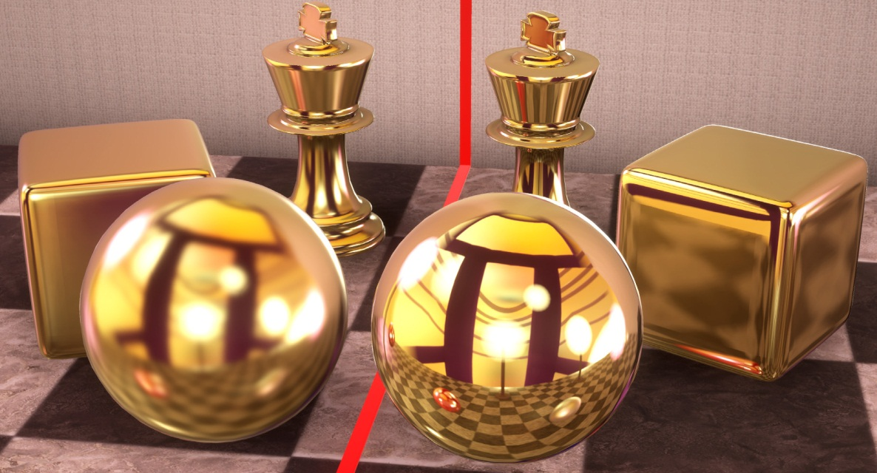
Problems with large shininess
In practice with IBL, materials still look glossy even with shininess of 1,000 or 2,000
  For mirror like materials, shininess of ten thousands is preferred
  Difficult to have high enough resolution mipmap textures, because of memory and performance issues
Adding the mirror reflection option
  When this functionality is turned
  on, the original high resolution
  texture is automatically chosen

Slide 39
IBL Blending
Blending is necessary when using multiple Image Based Lights
  Implemented blending between an SH light and an IBL
    Popping was annoying when the blend factor cross 50%
    Not practical
  Blending by fetching Radiance Map twice
    Diffuse term is blended with SH
    For optimization, this process is performed only for the specified attenuation zone
      Switching shader

Slide 40
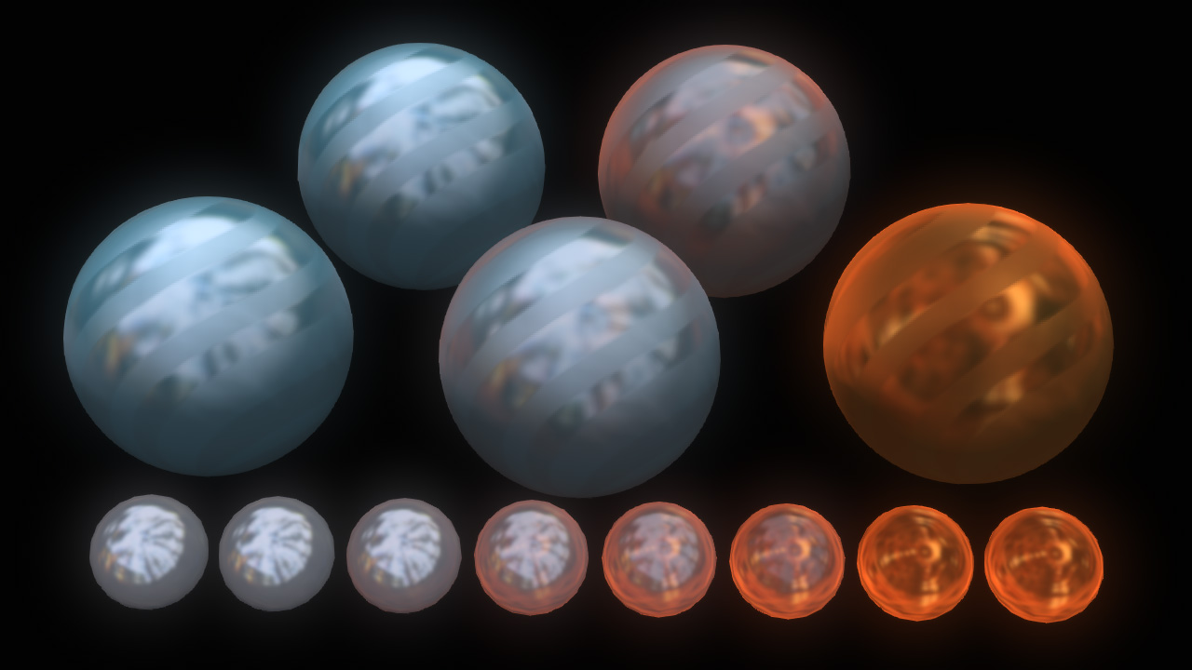
IBL Blending

Slide 41
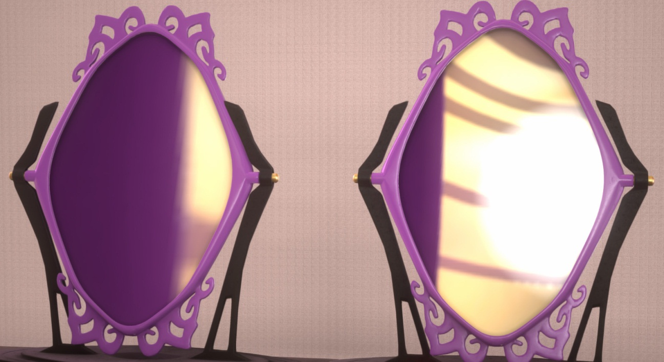
IBL Offset
A little tweak for a local reflection problem with IBL
  The usual method
    Reflection vector is modified according to the virtual IBL position
    c is computed from the IBL size, the object size and another coefficient which is adjusted by hand
With IBL Offset

Slide 42
Matching IBL with point light
In the case where area lighting becomes practical with IBL, punctual lights becomes problematic
  When adjusting specular for punctual lights, artists tend to set smaller (blurrier) shininess values than physically based values
    But it is too blurry for IBL
    When adjusted for IBLs, it is too sharp for punctual lights
  No way for artists to adjust specular without matching

Slide 43
Shininess hack
Not mathematical matching, but matching the result from punctual lights to the result from IBL
  Anyhow, this is a hack
    The coefficient can’t be precisely adjusted
      Depends on the shape of the object lit
      Depends on the size of the light source
  Shininess value is compensated by the lighting attenuation factor
    In the case of distant light source, shininess value tends to be the original shininess value
    In the case of close light source, shininess values tends to be smaller than the original value

Slide 44
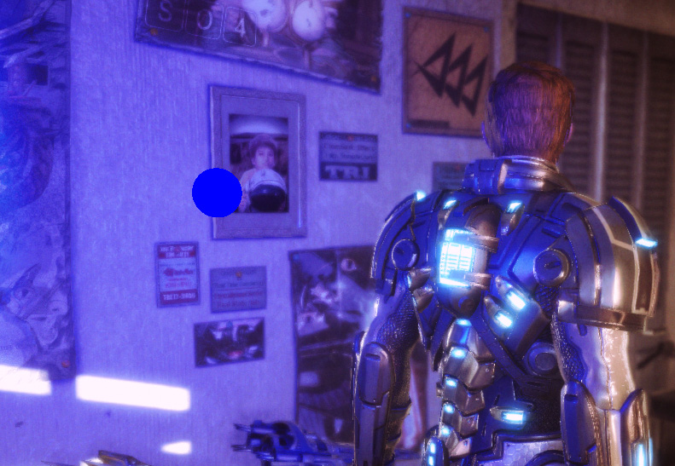
Shininess hack

Slide 45
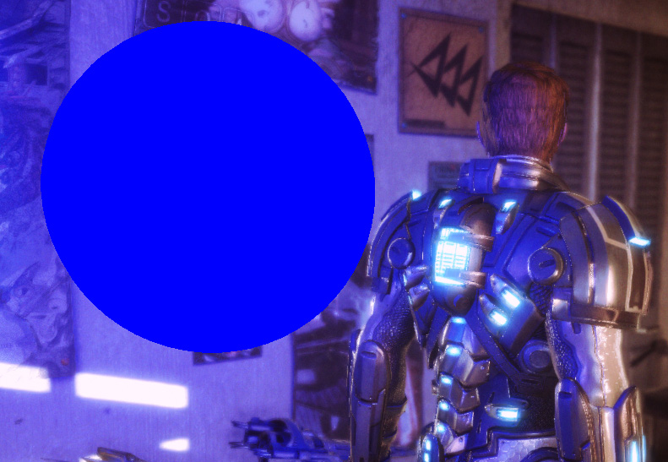
Shininess hack

Slide 46
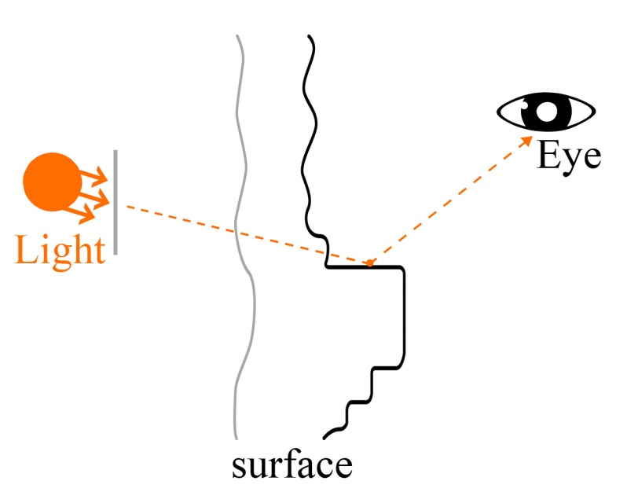
HDR IBL Artifact
The rendering result looks unnatural when the high intensity light that should be occluded is coming from grazing angles
  Generally multiply by the ambient occlusion factor
    Enough for LDR IBL
  The artifact is noticeable when HDR IBL has a big difference of intensities, just like the real world
    Multiplying by the ambient occlusion factor isn’t enough

Slide 47

HDR IBL Artifact

Slide 48
Why does the artifact occur?
Because it is physically based
  It is sometimes very noticeable
    It unnaturally looks too bright on some pixels (edge of objects)
  This artifact occurs when all of the following are present: Fresnel effect, high intensity value from HDR IBL, physically based BRDF models, and high shininess values
Example of a material with a refractive index of 1.5
 | Light intensity | E.H | Schlick | shininess | Result
Worst case | 10.0 | 0.1 | 0.61 | 500 | 12.644
Best case | 1.0 | 1.0 | 0.04 | 10 | 0.00502
A difference of about 2,500times!

Slide 49
Multiplying by AO factor
Is not enough
  Enough for LDR IBL and non physically based
    Unnoticeable
  Not enough for HDR IBL and physically based at all
    If an AO factor is 0.1,
      12.64*0.1=1.264 with the example
      Still higher than 1.0
  Need a more aggressive occlusion factor

Slide 50
Novel Occlusion Factor
Need almost zero for occluded cases
  Not enough with 0.3 or 0.1 for HDR
    Need 0.01 or less
  Very small values for not occluded area are problematic
  Need to compute an occlusion term designed for the specular component
    High-order SH?
    No more extra parameters!

Slide 51
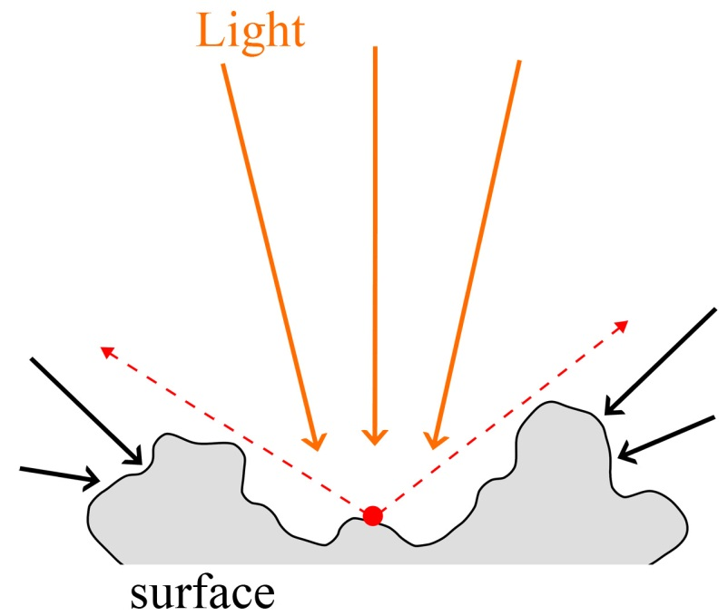
Specular Occlusion
SO is acquired from AO
  Use AO factor as HBAO or SSAO
    But precomputed AO factor is not HBAO factor
      Using AO factor as HBAO factor that assumes that the pixel is occluded by the same angle for all horizontal directions
      In other words, you can consider that the same occlusion happens for all directions in the case of SSAO

Slide 52
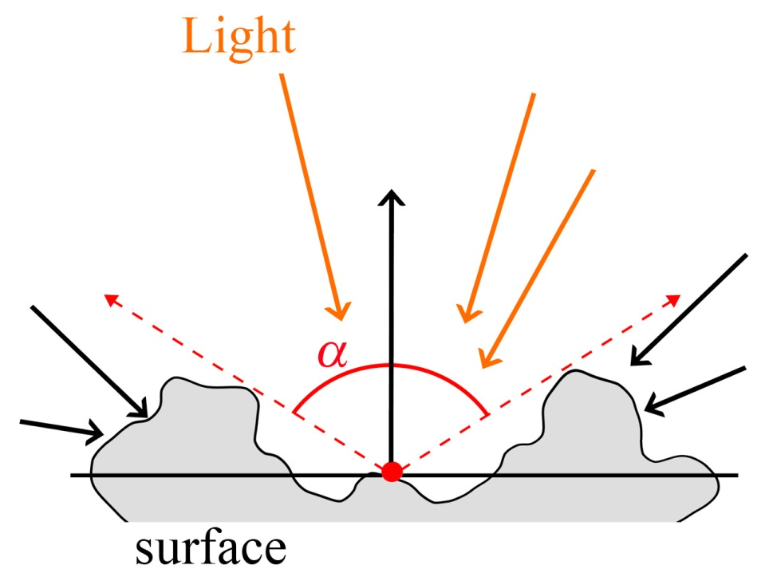
Aqcuire Specular Occlusion
In the case where a pixel is isotropically occluded from the horizon without gaps
  AO factor becomes
  Neither conventional AO nor HBAO
  are isotropic for horizontal directions,
  but Specular Occlusion forcibly
  assumes that it is

Slide 53
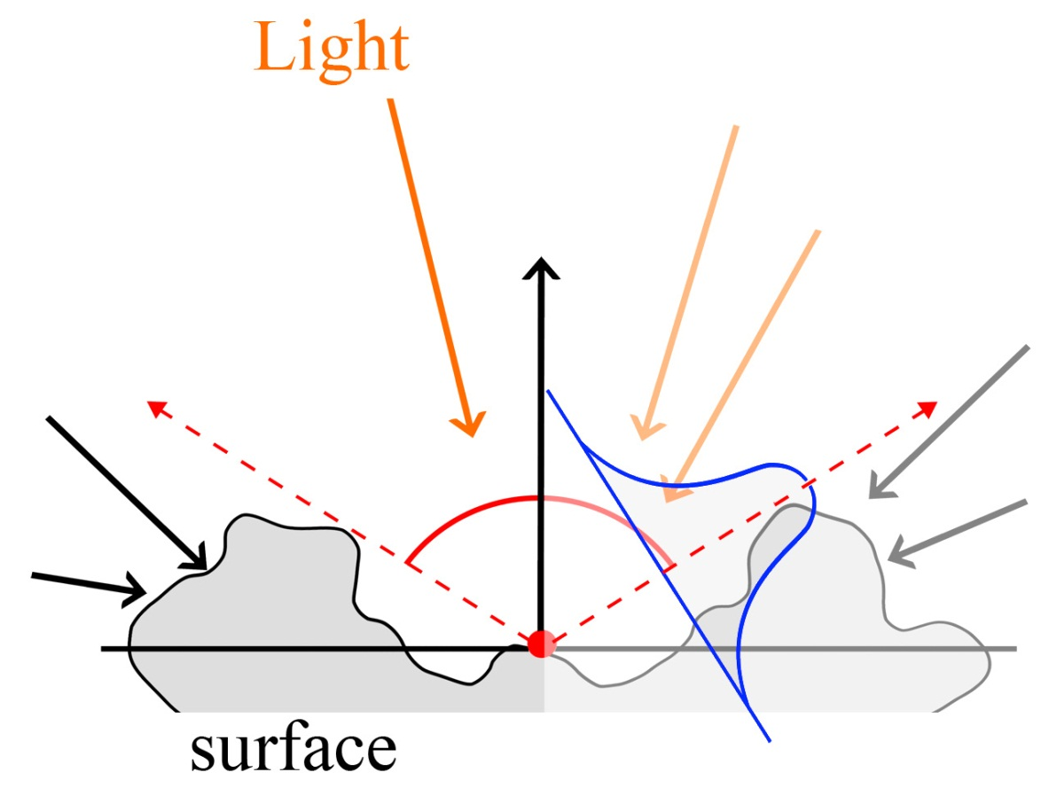
Specular Occlusion implementation
Required SO (Specular Occlusion) factor should satisfy the following as much as possible
  Where θ = 0, SO = 0
  Where θ = cos⁻¹(AO^{0.5}), SO = 0.5
    Specular term becomes 0.5
    where the pixel is occluded by
    a half at the occluded position
  Where θ = π /2, SO = 1

Slide 54
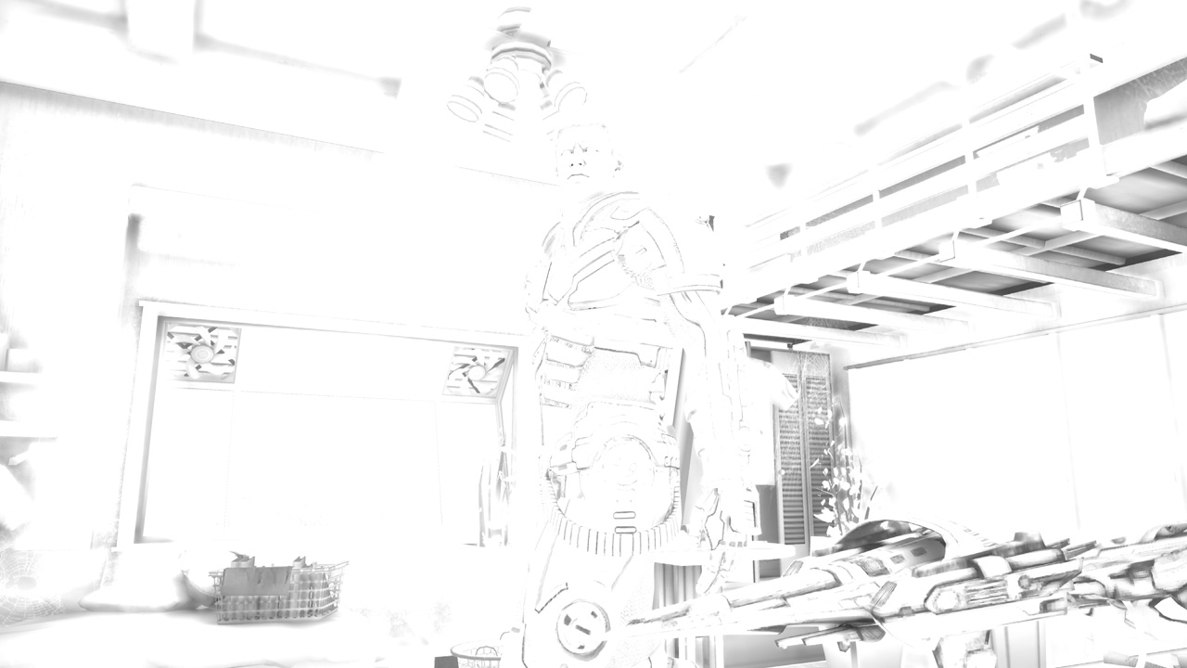
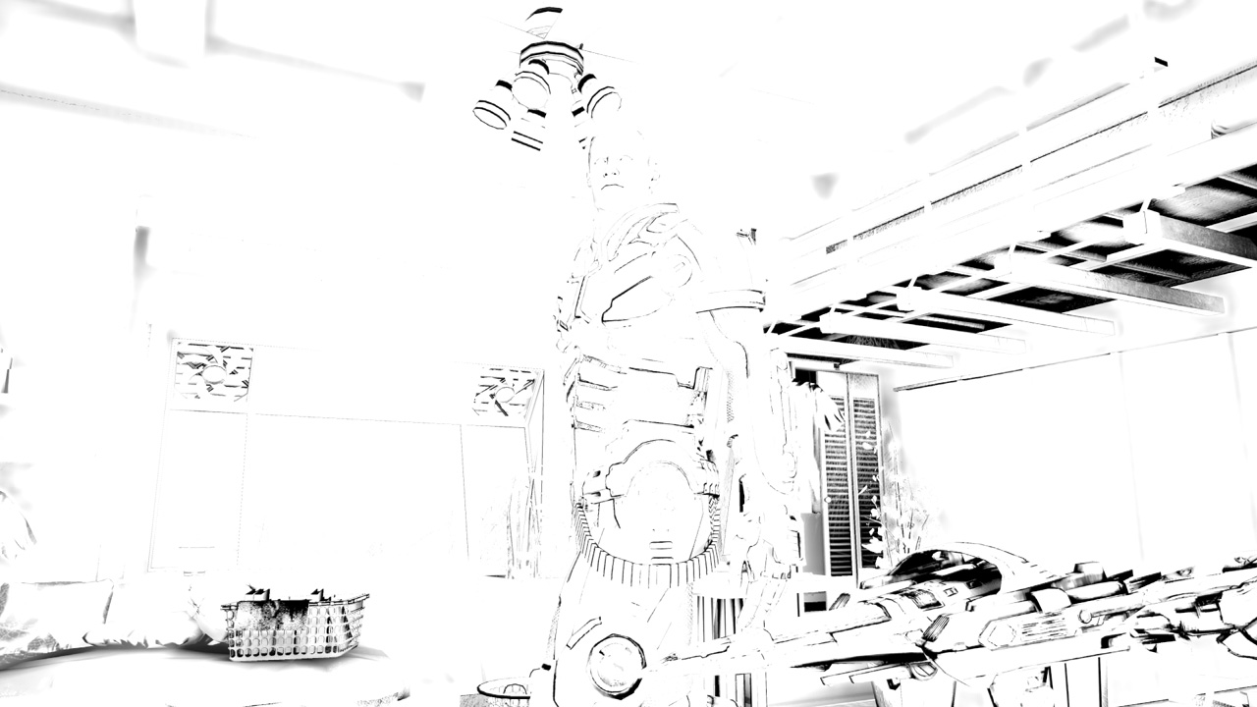
Specular Occlusion
Specular Occlusion
Ambient Occlusion

Slide 55
SO implementation (1)
The first equation that satisfies the condition
  Though this satisfies the conditions as Specular Occlusion, it is not physically based
  Since Specular Occlusion literally represents the occlusion factor for the specular term, it should be affected by the shininess value

Slide 56
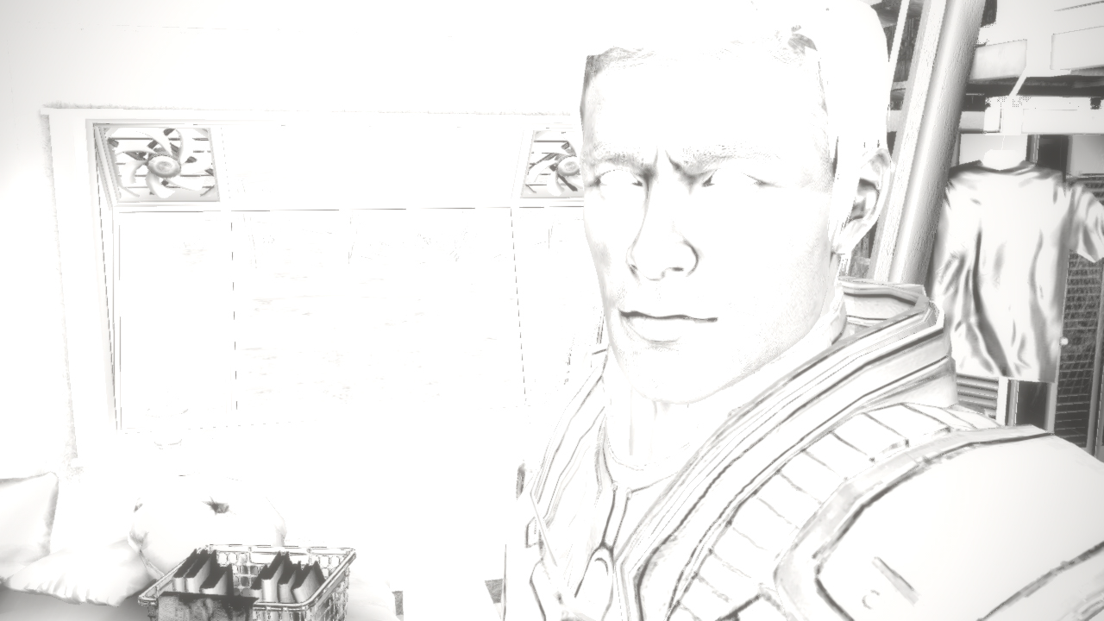
SO implementation (1)

Slide 57
SO implementation (2)
Equation taking into account the shininess value
  More physically based than the first one
  SO suddenly changes with larger shininess values
  High computational cost with Pow
    A little visual contribution to the result
    Smaller occlusion effect than expected

Slide 58
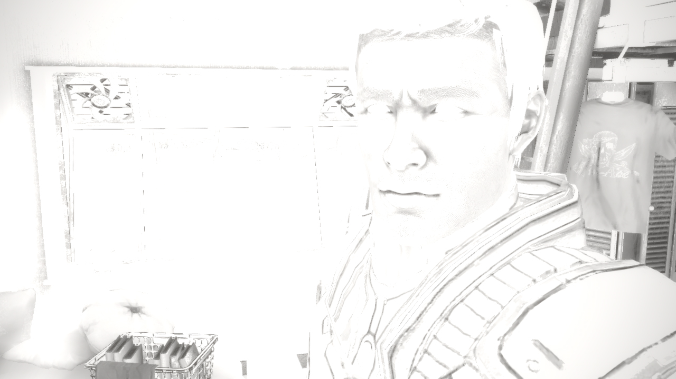
SO implementation (2)

Slide 59
SO implementation (3)
Optimizing the second equation
  The physically based correctness with respect to shininess decreases
  Stable as SO doesn’t take into account shininess
    Average occlusion effect becomes stronger
  Optimized
    The balance between quality and cost is good

Slide 60
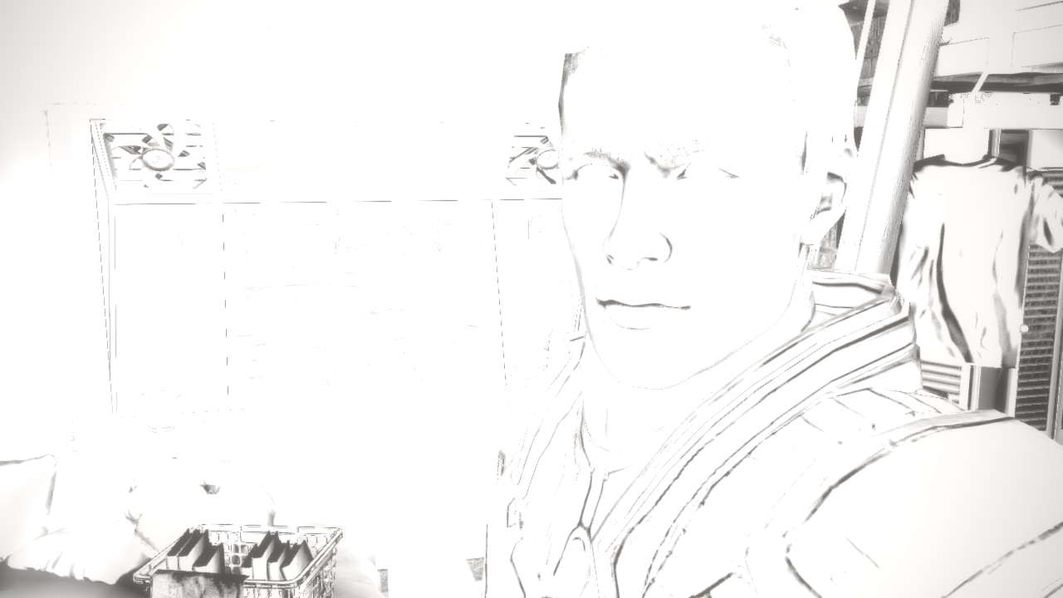
SO implementation (3)

Slide 61
Ambient specular term computation
Computing the final ambient term
  With this equation, the pixel gets black, because the occluded pixel isn’t lit by the ambient lights
    In reality, the pixel would be illuminated by the some light reflected by some of the objects (interreflection)
    The diffuse term has the same issue
      AO itself is not such an aggressive occlusion term
      Diffuse factor does not have such a high dynamic range
      Not problematic
    Problematic for the specular term
      Unnaturally too dark

Slide 62
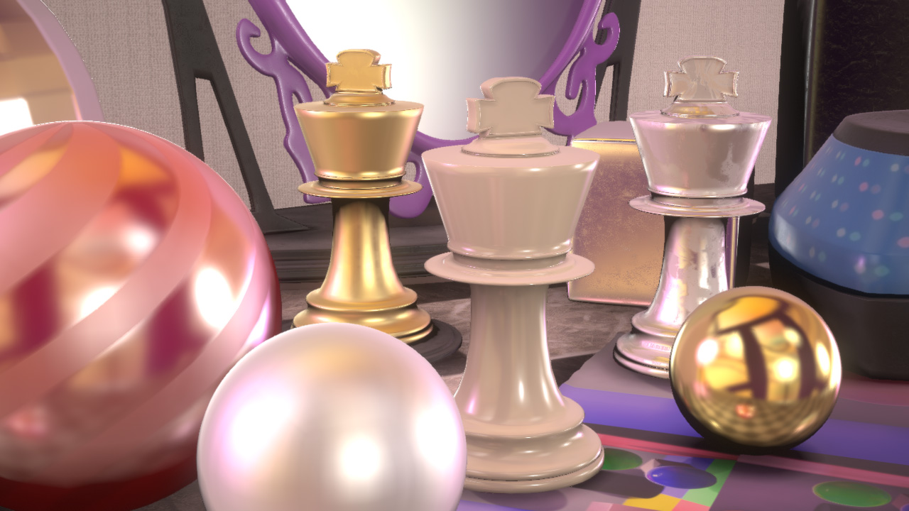
Ambient specular term computation

Slide 63
AS term computation (1)
Computing pseudo interreflection
  Fundamentally, it should take into account light and albedo at the reflected point
    Because this implementation is “pseudo”, it takes into account light and albedo at the shading point
The results
  Visually, we desired a little more aggressive occlusion effect
    Not based on physics
  Depending on the position, the rendering result becomes strange
    This implementation does not take into account the actual interreflection

Slide 64
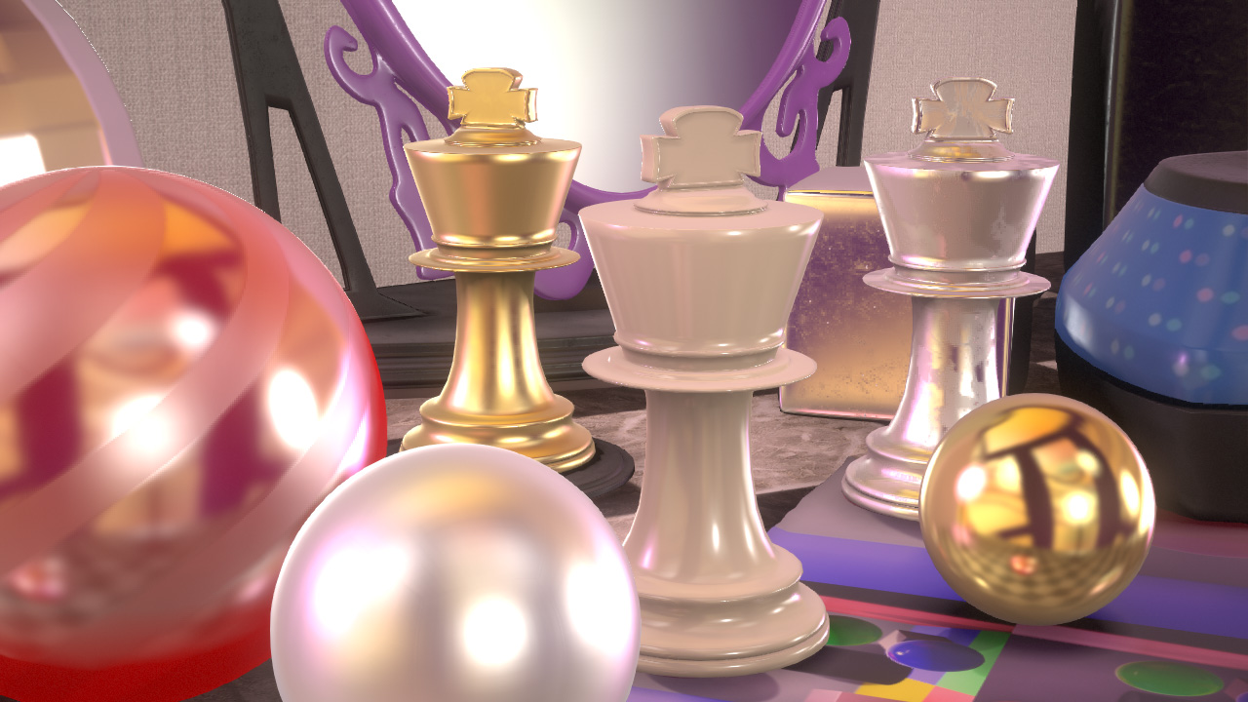
AS term computation (1)

Slide 65
AS term computation (2)
Multiplying by the AO factor instead of albedo
  Interreflection like effect becomes smaller, but the occlusion effect becomes stronger
    Visually preferable
    Eventually, it depends on your preference
    It is a good choice to make this an option for artists

Slide 66
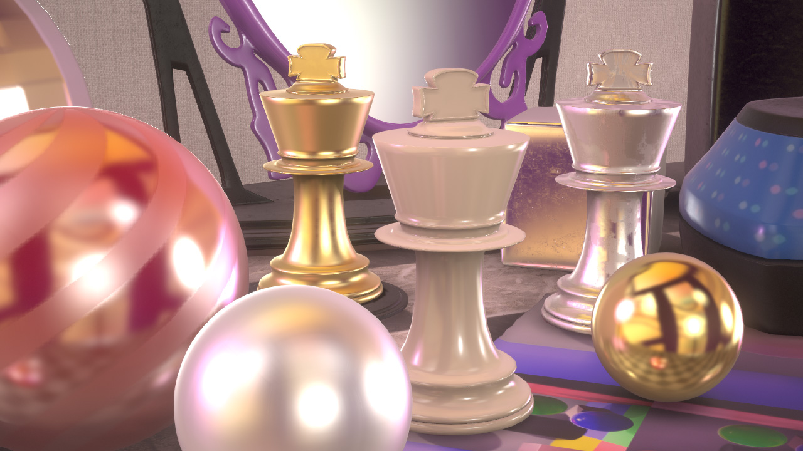
AS term computation (2)

Slide 67
AS term computation (3)
Again, the AO factor is multiplied by the specular term
  Makes the specular effect for ambient lighting robust
    Not based on physics
    The SO factor itself approximates the approximation
    Relatively adjusted to conservative result
      It also depends on your preference

Slide 68
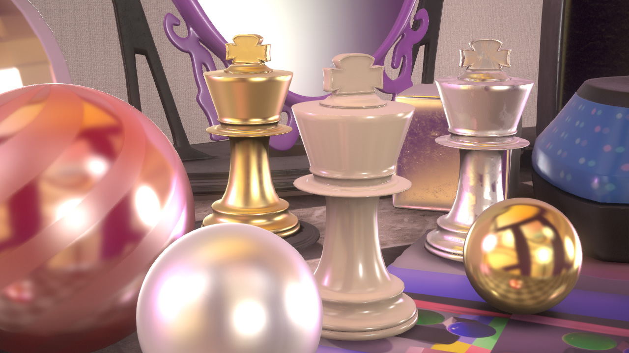
AS term computation (3)

Slide 69
AS term computation (4)
The secondary AO factor is only multiplied by the diffuse term
  Still your preference
    This term is optional according to your preference
    Not physical reason, but artistic direction

Slide 70
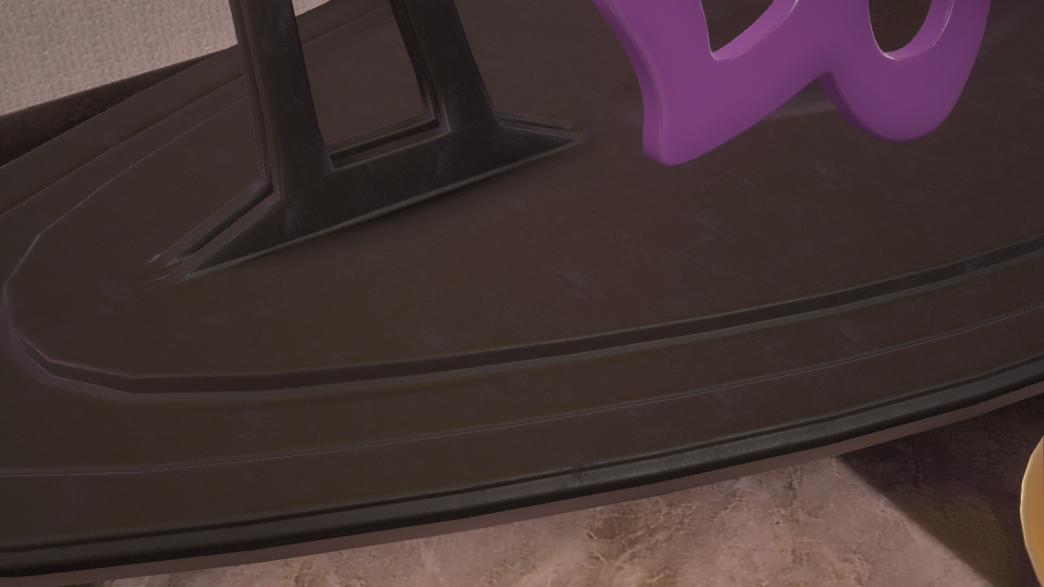
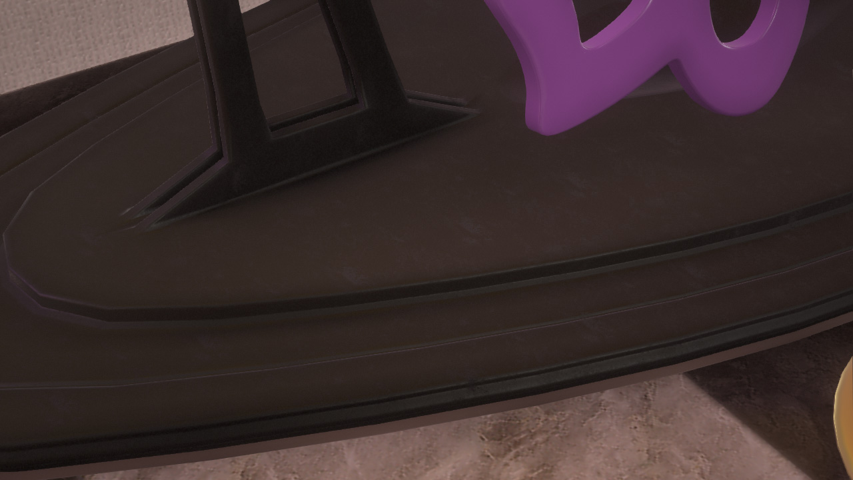
AS term computation (4)

Slide 71
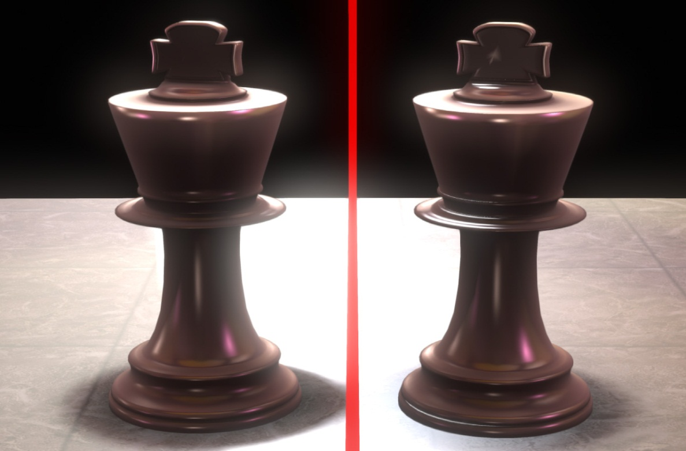
Applying to the entire specular term
SO factor is also available for the specular term with punctual lights
  In our case, this is used for punctual lights
    Big advantage with HDR, physically based materials and textures
With Specular Occlusion

Slide 72

W/o Specular Occlusion (Only AO)

Slide 73

With Specular Occlusion

Slide 74
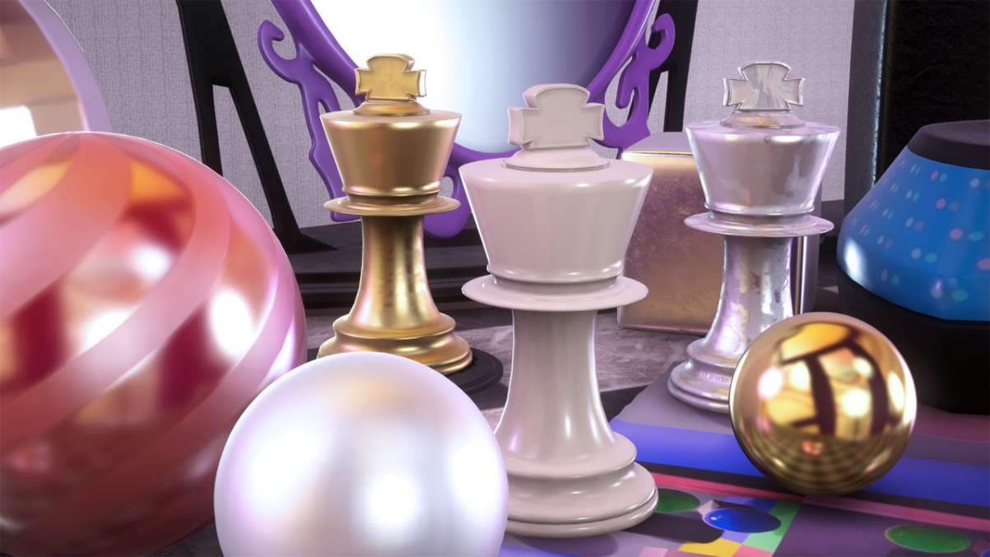
IBL performance
ms @ 1280x720
 | IBL | IBL+ 1direct light | SH | SH (no AmbientBRDF)
X360 | 5.8 | 7.0 | 5.0 | 4.5
PS3 | 5.9 | 7.9 | 5.1 | 4.3

Slide 75
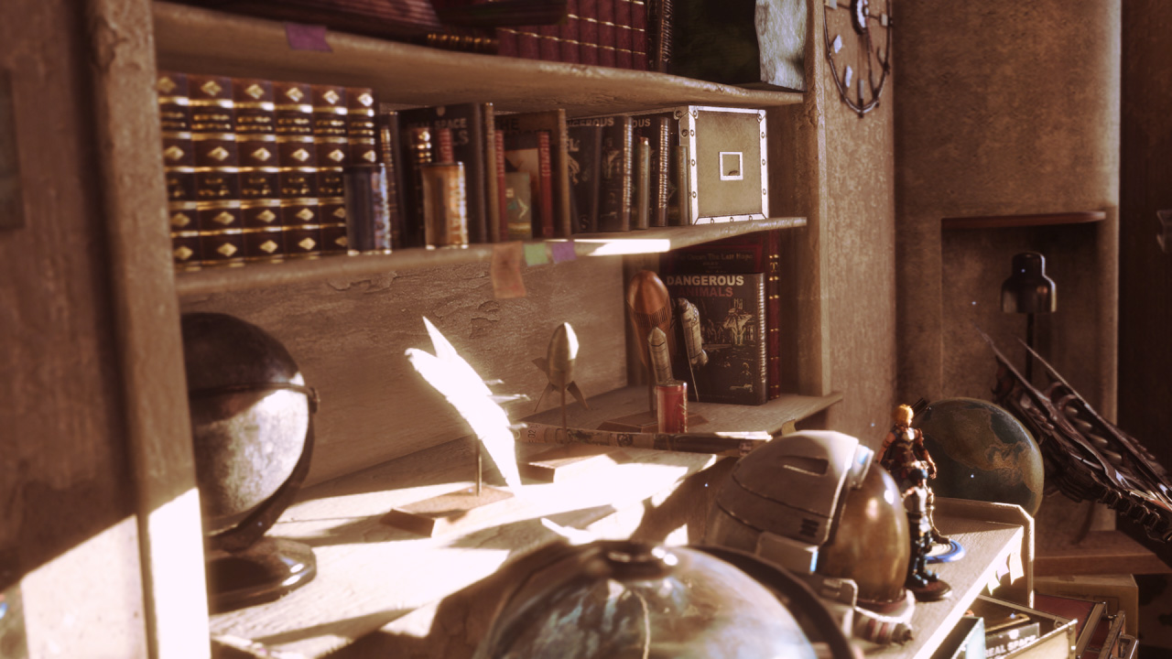
Physically based IBL

Slide 76
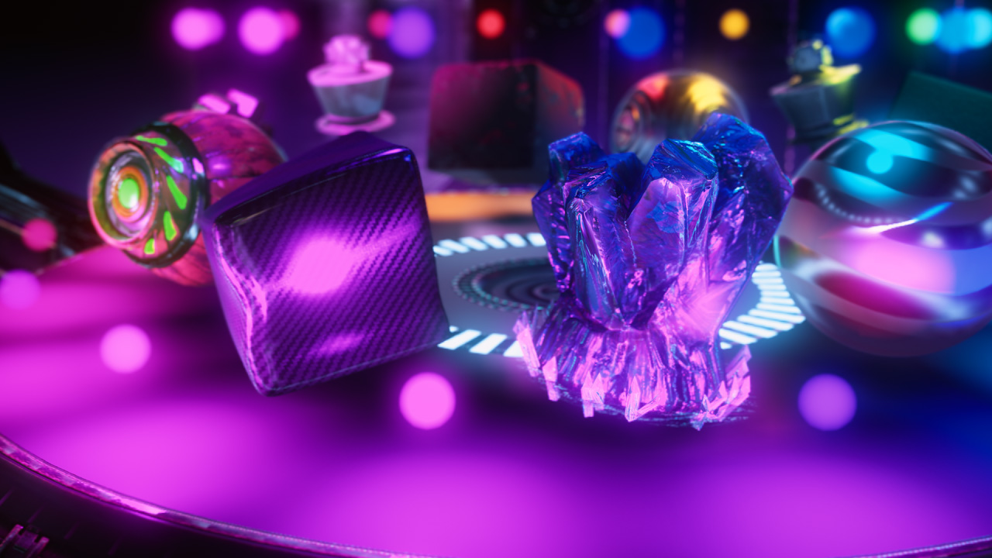
Physically based IBL

Slide 77


Physically based IBL
Without the specular term for IBL
With the specular term for IBL

Slide 78
Conclusion
When using physically based IBL
  Area lighting which is difficult with punctual lights becomes feasible
    Soft lighting by a large light source
    Sharp lighting by a small light source
  Consistent material representation with scenes by either direct and indirect lighting
    Reduce hand adjustment by artists
    Easy to set physically correct parameters to materials
  True HDR representation becomes possible

Slide 79
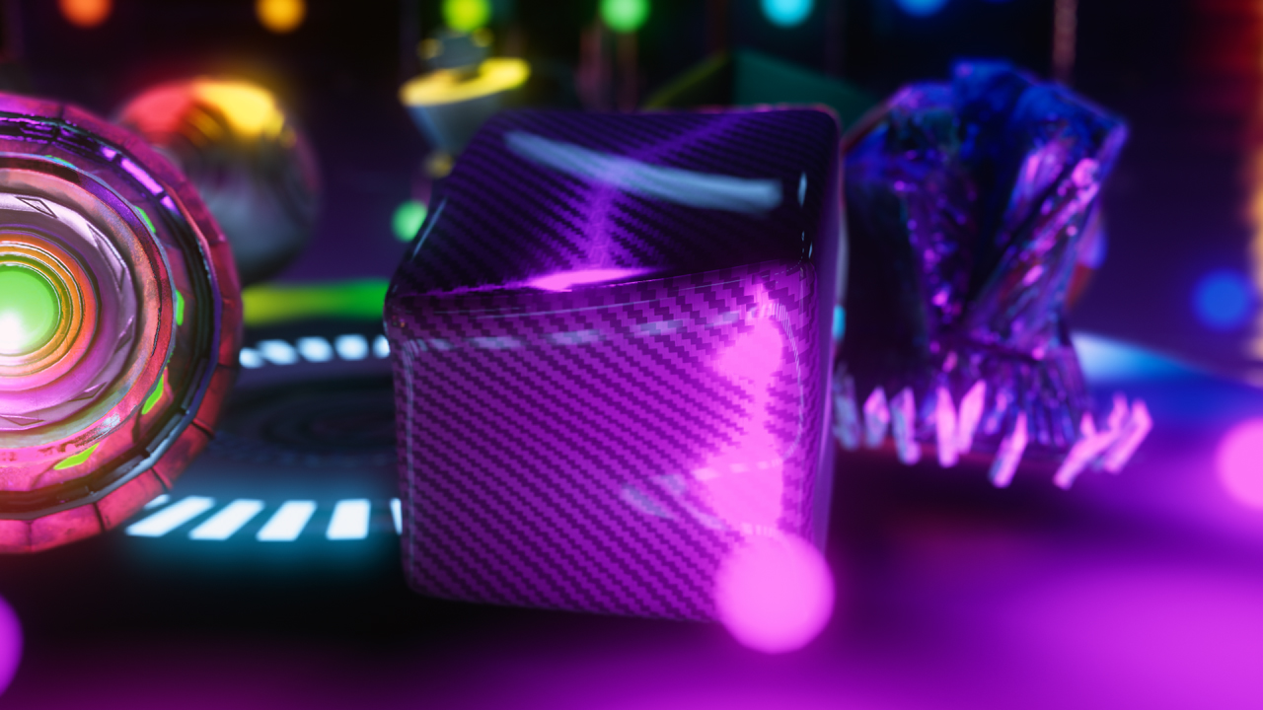
Acknowledgements
R&D department, tri-Ace, Inc.
  Tatsuya Shoji
  Elliott Davis
Thanks for the English version
  Sébastien Lagarde, Marc Heng
  and Naty Hoffman

Slide 80
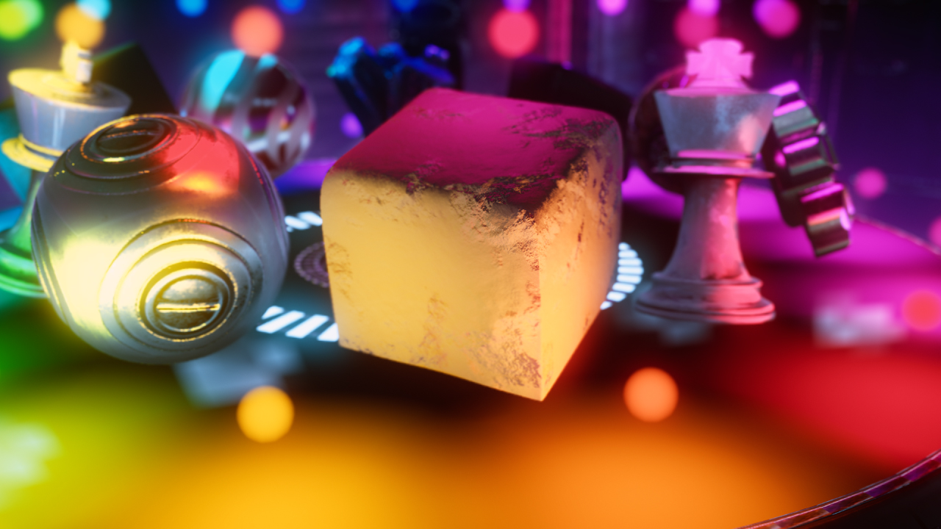
Questions?
http://research.tri-ace.com

