Slide 2
Wavefront Tracing for Precise Bokeh Evaluation Real-time Rendering of Physically Based Optical Effects in Theory and Practice Masanori KAKIMOTO Tokyo University of Technology
Notes:
Hello. I have a 30 minute slot and have two sets of slides.
(10 sec)

Slide 3
Wavefront Tracing for Precise Bokeh Evaluation Table of Contents
Introduction
Brief overview of wavefront tracing
Examples from eyeglass lens simulation
Conclusion
Notes:
For the first 10 minutes, I will briefly introduce wavefront tracing
and its application to bokeh evaluation in eyeglass lens design.
(12 sec)

Slide 4
Introduction
Real-time Rendering of Physically Based Optical Effects in Theory and Practice
Wavefront Tracing for Precise Bokeh Evaluation
Notes:
Let me start with introduction.
(3 sec)

Slide 5
Applications of Wavefront Tracing
[Kneisly 1968]
Caustics [Stavroudis 1972] [Mitchell 1992]
Rendering with bokeh
Accurate evaluation of bokeh size
Can take human visual acuity into account
Utilized in engineering fields (eyeglass lens design, ophthalmology)
Notes:
First of all, I’ll show what have been done using wavefront tracing.
In early research work it was used for caustics of light,
which is out of scope of my talk today.
Defocusing, or bokeh is another application of wavefront tracing.
The bokeh size is more accurately computed than other methods.
Human visual a-CU-ity can be taken into account.
And bokeh by wavefront tracing is used only in engineering fields,
not in entertainment or games yet, as far as I know.
(42 sec)

Slide 6
Basic Premises
An option for ray tracing
Rays are given input
Pay attention to a point on the wave front
The cross point of the ray and the wave front
Note that wavefront tracing is a geometric optics technique, not a wave optics method
Notes:
Let me make clear some assumptions, or basic premises.
Wavefront tracing is used with ray tracing.
The generated rays are the input of wavefront tracing.
We pay attention only to a point on the wave front,
which is the cross point between the ray and the wave front.
Please notice that wavefront tracing is not a wave optics method,
rather, it is a ray-based, extended geometric optics technique.
(40 sec)

Slide 7
Input / Output for Each Trace
Input:
A series of rays (from screen to an object surface point)
Wave source point (either end point of the rays)
Refractive indices or power of the media on the way (eyeglass lens, eye lens)
Aperture (Pupil) diameter
Output:
Wave front curvatures
Extent of the light beam at any point of the ray
Notes:
Let me also make sure what are input and output for each trace of the method.
Input data are:
A set of refracted rays,
Wave source point, which must be either end of the ray,
Refractive indices or refractive power of the media through which the rays travel,
AND
the aperture diameter.
Output data are:
Wave front curvatures
AND
Spread of lightwave at anywhere on the ray.
(30 sec)

Slide 8
Brief overview of wavefront tracing
Real-time Rendering of Physically Based Optical Effects in Theory and Practice
Wavefront Tracing for Precise Bokeh Evaluation
Notes:
Now I’ll very briefly describe wavefront tracing.
(6 sec)

Slide 9
Wavefront Tracing from an Object Point
Evaluates bokeh while back tracing from arbitrary object points [Loos 1998] [Kakimoto 2007]
Retina
Wave source
Wave front
Object space
(View volume)
Cornea
Central fovea
Eyeball
Pupil
Evaluated bokeh (output)
Light path
(given by ray tracing)
Eyeglass lens
Notes:
This illustration describes the overall concept of wavefront tracing.
This is an implementation example, tracing from an object point, all the way to the screen or the central fovea of the retina.
The wave source is the point where you would like to compute the bokeh size.
Again the rays have been pre-generated by ray tracing.
The wave front is back traced along the rays illustrated as red,
all the way through the air, eyeglass lens, human eye lens, and vitreous in the eyeball.
Finally the bokeh at the retina is evaluated as an ellipse of confusion.
(50 sec)

Slide 10
Wavefront Tracing from the Eye
Evaluates bokeh at object space points [Kakimoto 2010]
Efficient for precomputing a spatial distribution of bokeh
Retina
Wave front
Evaluated bokeh
Object space
(View volume)
Cornea
Central fovea
(Wave source)
Eyeball
Pupil
Eyeglass lens
Notes:
This is an alternative implementation.
Wavefront is traced from the eye into the object space.
This is convenient for computing object space bokeh size.
Along a ray you can obtain multiple bokeh results easily.
You can efficiently precompute a spatial distribution of bokeh in the view volume.
(23 sec)

Slide 11
Descriptions of a Wavefront
Normal vector $N$
Principal curvatures $κ_{1}$ and $κ_{2}$
Principal directions $e_{1}$ and $e_{2}$
radius =$−\frac{1}{κ_{2}}$
light path
$$e_{2}$$
$$e_{1}$$
typedef struct {
Vec3f N;
float k1;
float k2;
Vec3f e1;
Vec3f e2;
} Wavefront;
radius =$−\frac{1}{κ_{1}}$
$$N$$
Notes:
Now I’ll explain some details of wave front tracing.
We pay attention ONLY to the cross point between the wave front and the ray, or the light path.
We describe the wave shape on that point with 5 variables,
which are wavefront normal vector N;
principal curvatures, and their directions.
While tracing, we will carry out several operations each of which transforms these variables.
(33 sec)

Slide 12
Wavefront Operation (1) Transfer
$$κ_{2}$$
$$κ_{2}^{′}$$
$$κ_{1}^{′}=\frac{κ_{1}}{1−dκ_{1}}$$
$$κ_{2}^{′}=\frac{κ_{2}}{1−dκ_{2}}$$
$$κ_{1}$$
light path
$$e_{2}$$
$$κ_{1}^{′}$$
$$e_{1}$$
incoming wave
$$e_{2}^{′}$$
$$N$$
$$e_{1}^{′}$$
$$N^{′}=N$$
$$e_{1}^{′}=e_{1}$$
$$e_{2}^{′}=e_{2}$$
$$N^{′}$$
unchanged
$$d$$
outgoing wave
Notes:
The first operation is introduced in this slide.
Transfer is a simple operation.
It converts curvatures, but leaves three directional vectors unchanged.
Note that the curvature is negative if the curvature center is opposite to the wave movement.
The transfer usually occurs from a medium boundary to the next boundary.
(26 sec)

Slide 13
(2) Refraction by Refractive Index
Snell’s Law in the wavefront form
The boundary is represented the same way
$$κ_{2}^{′}$$
$$κ_{2}$$
refractive index $n_{i}$
$$e_{2}^{′}$$
$$κ_{2}^{(s)}$$
$$e_{1}^{′}$$
$$κ_{1}$$
$$e_{2}$$
$$N^{(s)}$$
$$e_{2}^{(s)}$$
$$κ_{1}^{′}$$
light path
light path
$$e_{1}$$
$$N^{′}$$
$$κ_{1}^{(s)}$$
$$e_{1}^{(s)}$$
light path
$$N$$
refractive index $n_{o}$
Incoming wave
Media boundary
(e.g. lens surface)
Outgoing wave
Notes:
The next operation is refraction.
All the 5 variables are converted in general.
This is just the Snell’s Law described in the wavefront form.
The expression is omitted here because it is a little complicated,
three step conversion including some coordinate transformations.
Please refer to some of the references for the mathematical formulas.
Those references will be included in the course note we will upload after the conference.
In this slide, please notice that the refractive media boundary shape is represented in the same way as the wave front.
(34 sec)

Slide 14
Other Wavefront Operations
Refraction by a refractive power
Human visual acuity is represented by a refractive power
Reflection
Optionally accompanied by Conoid Tracing
Assumes a circular aperture
Traces the shapes of ellipses along the ray
For details, see [Kakimoto 2011]
Notes:
There are some other operations to transform the wavefront such as reflection.
I introduce an optional method to evaluate the shape of the skinny cone-like light beam,
which I call Conoid Tracing, assuming that the aperture is circular since the pupil of human eye is nearly circular.
Note that Conoid Tracing is my research work and is not widely utilized yet.
(33 sec)
円形絞りは人間の眼を想定しているから、ということを説明

Slide 15
Conoid Tracing for Defocus Simulation
initialization
refraction
light spread evaluations
transfer
transfer
transfer
central fovea of retina
refraction
eyeball
sampling points
eye lens (thin lens)
pupil (aperture)
eyeglass lens
Notes:
This slide demonstrates the conoid tracing process for a trace.
Since we assume the aperture shape is circular,
the outgoing bundle of light beam forms a cone-like shape
and a 2D shape sectioned by a screen perpendicular to the beam is always ellipse.
(25 sec)

Slide 16
Conoid: A Bundle Shape of Light
Sturm’s Conoid [ophthalmology term] A cone-like shape that is formed by a bundle of light that passes through a circular aperture of a non-spherical lens
Astigmatic lenses
Circular aperture
Vertical Focus
Circle of least confusion
(COLC)
Horizontal Focus
Notes:
The bundle of ray that exited from a circular aperture and astig-MAT-ic lenses, FORMs a little complicated cone-like shape.
In ophthal-MO-logy, it is called STURM’S CONOID, which, in general, does not converge to a point.
Instead, there exists a circle of least confusion accompanied by horizontal and vertical focal lines on both sides, respectively.
Conoid tracing analyzes the shape and obtains cross sections at arbitrary depths.
(40 sec)

Slide 17
Examples
Real-time Rendering of Physically Based Optical Effects in Theory and Practice
Wavefront Tracing for Precise Bokeh Evaluation
Notes:
I’m going to show some bokeh examples and real-time rendering results.
(8 sec)

Slide 18
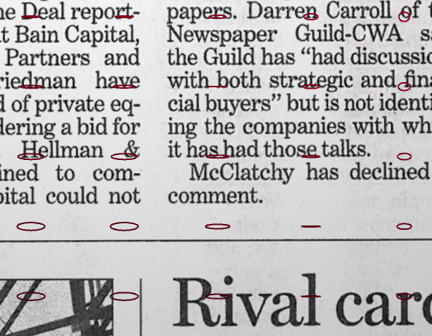
A View with an Astigmatic Eye
Bokeh shapes computed by conoid tracing
Image without bokeh rendering
Bokeh rendering output
11cm
Distances from the eye
6cm
Notes:
This example demonstrates a simulated view with an astig-MAT-ic eye.
In the left image bokeh rendering is disabled but the bokeh shapes computed by conoid tracing are visualized.
These bokeh shapes are from the precomputed set of distribution in the view volume.
Note that the distances from the eye to the newspaper surface are very small.
Thus, the viewer cannot focus on the newspaper due to the limit of accommodation ability.
The right image is a real-time rendering result according to the bokeh distribution.
(43 sec)

Slide 19
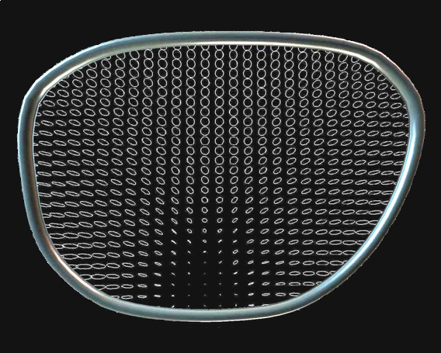
Myopia and presbyopia corrected by a progressive lens in design
27cm
Simulated bokeh ellipses
Notes:
Since this work is a collaboration with a major eyeglass lens company, the system is currently used to verify the design of high-end progressive addition lenses.
This result represents the bokeh distribution at a near distance.
The assumed patient has myopia and presbyopia with his eye, and the view is corrected by a progressive lens under design.
The lower portion of the lens is supposed to correct defocus due to presbyopia, and it is successful.
Note that the bokeh sizes are exaggerated to make them easier to observe.
(45 sec)

Slide 20
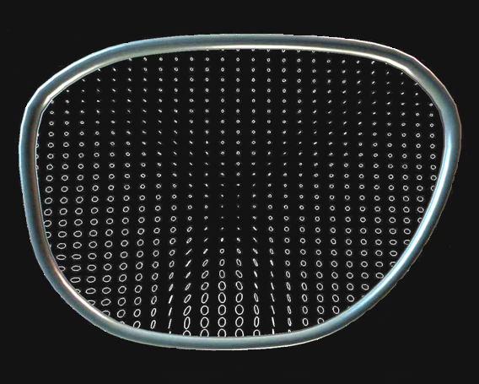
Myopia and presbyopia corrected by a progressive lens in design
78cm
Simulated bokeh ellipses
Notes:
This is another example of bokeh sizes at a different distance, 78 centimeters.
The central portion of the lens results in a focused image.
(14 sec)

Slide 21
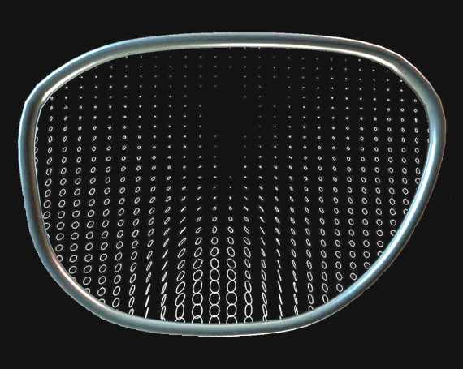
Myopia and presbyopia corrected by a progressive lens in design
340cm
Simulated bokeh ellipses
Notes:
The last bokeh size example is for a farther distant depth.
A relatively large upper portion of the lens is doing a good job to correct the myopia defocus of the patient.
Note, that in the lower portion, large bokeh sizes are observed because the portion is tuned for the near depths.
(25 sec)

Slide 22
Rendering of Progressive Lens View
Progressive lens
Naked eye reference
Notes:
This slide shows a real-time rendering result through a progressive lens.
The right most images are references from a simulation without the lens.
This patient is also supposed to have myopia and presbyopia and CANNOT focus well at far distances or at near distances.
The designed progressive lens successfully corrects both of the syndromes.
(30 sec)

Slide 23
Near Real-Time Bokeh Rendering with Vertex Displacement
Use of precomputed bokeh distribution in the view volume
Vertex shader Implementation
Displaces vertex within the bokeh ellipse at the point
Blend images with sampled displacements
Pixel shader implementation may be possible
Notes:
So how could we render the bokeh in real-time?
We used a precomputed bokeh distribution in the view volume,
and used a vertex shader which displaces each vertex within the bokeh ellipse at the point.
While changing the sampled displacement, result images are simply blended.
I think someone here may be able to do the similar thing much faster using pixel shader or other sophisticated GPU functions.
(35 sec)

Slide 24
Conclusion
Real-time Rendering of Physically Based Optical Effects in Theory and Practice
Wavefront Tracing for Precise Bokeh Evaluation
Notes:
To conclude,
(5 sec)

Slide 25
Conclusion
Wavefront tracing is a powerful tool to analyze spread of light precisely
Conoid tracing evaluates the bokeh sizes derived from a circular aperture
Applied to eyeglass lens design verification
Not yet used in the game or content community
Notes:
Wavefront tracing is a powerful tool to analyze spread of light precisely.
Conoid tracing evaluates the bokeh sizes derived from a circular aperture.
An application is used for eyeglass lens design verification
It is a manufacturing industry project and the method is not yet used in the game or content community.
(30 sec)

Slide 26
References
Gullstrand, A., VON Helmholtz, V. H. 1909. Handbuch der Physiologischen Optik. p. 335.
Kneisly, J. A. 1964. Local curvature of wavefronts in an optical system. Journal of the Optical Society of America, 54, 2, 229–235.
Stavroudis, O. N. 1972. The Optics of Rays, Wavefronts, and Caustics. Academic Press, New York and London.
Mitchell, D., Hanrahan, P. 1992. Illumination from Curved Reflectors. Proc. SIGGRAPH’92, 283–291.
Loos, J., Slusallek, P., Seidel, H.-P. 1998. Using wavefront tracing for the visualization and optimization of progressive lenses. Computer Graphics Forum 17, 3 (Proc. Eurographics 1998), 255–263.
Kakimoto, M., Tatsukawa, T., Mukai, Y., Nishita, T. 2007. Interactive simulation of the human eye depth of field and its correction by spectacle lenses. Computer Graphics Forum 26, 3 (Proc. Eurographics 2007) , 627–636.
Kakimoto, M., Tatsukawa, T., T., Nishita, T. 2010. An Eyeglass Simulator Using Conoid Tracing. Computer Graphics Forum, 29, 8, 2427-2437.

